Slide 1



best practices for recruiting & hiring student employees
Human Resources
May 2025

Slide 2

today’s conversation
New policies
Basic facts about student employment
Recruiting a candidate pool
Hiring process

Slide 3



new policies
(1) Priority Hiring for Students with Work Awards
(2) Maximum Number of Work Hours for On-Campus Employment

Slide 4

priority hiring for students
with work awards
Departments are required to give priority to students with work awards when hiring student employees.
All positions must be posted in Handshake, and “work award” must be checked for the first week of posting.
Supervisors are encouraged to repost employment opportunities each year to give all students the chance to apply.

Slide 5

Policy on Maximum number of work hours for on-campus student employment
Students may work no more than 15 hours per week across all on campus jobs during the regular academic year.
Students wanting an exception to this policy for financial reasons should seek approval from the VP Kazi Joshua.
Positions that require students to work hours over 15 for very short periods of time may be considered for approved exceptions ahead of time by Human Resources.

Slide 6
  Whitman’s work study-eligible student population has increased every year over the last several years (last year was 800 students & this year is 896 students).
  Departments benefit from hiring students with work awards because you support one of Whitman’s strategic priorities, and you receive reimbursements when you hire an eligible student, so long as your position is work-study approved.
  Student employees work in nonexempt, temporary positions.
  To be in a student employee position, a student must be currently enrolled in 6 credits or more,, except for seniors in their last semester.
  Students can never work outside of the United States.
  Student employees accrue paid sick leave at a rate of one hour of paid sick leave for every 40 hours worked.
The facts about work awards

Slide 7



Create a position description using the required template.
How do I get a position approved for work study?
Complete a student position change/creation form.

Slide 8


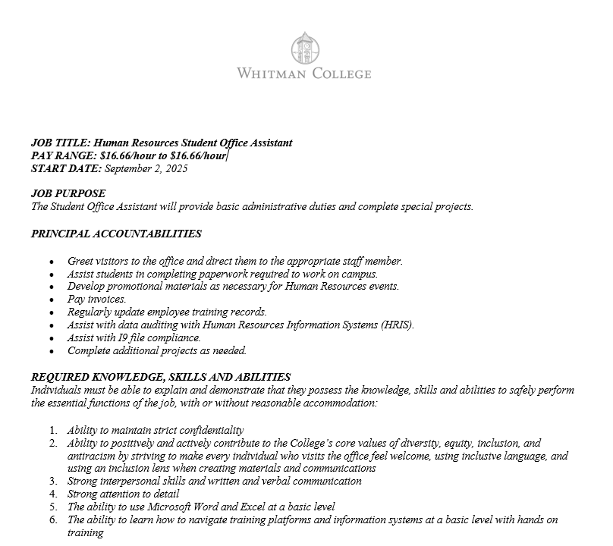

it all starts
with an inclusive
position description

Slide 9
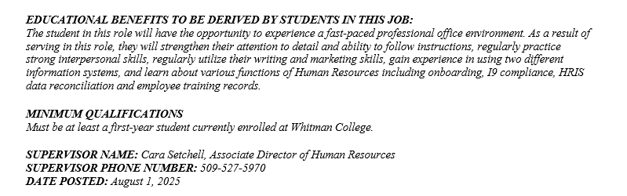
it all starts
with an inclusive
position description

Slide 10

Create a posting in handshake
  All student positions must be posted in Handshake.
  Access Handshake
    https://app.joinhandshake.com/emp
    Log in using your Whitman ID and password.
  Tour of Handshake & review of employer guides.

Slide 11

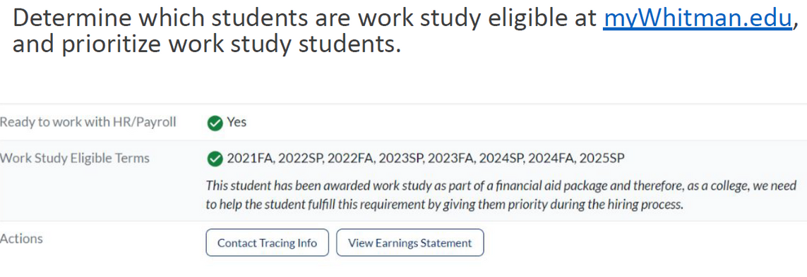

Review applications
determine which students are work study eligible aT myWhitman.edu and prioritize work eligible students.
Prioritize first-year students for entry level positions.
do an initial screening of applications by using the qualifications & required knowledge, skills & abilities.
If too many applicants remain, narrow the pool by asking students to verify that they can work during the hours you need.

Slide 12


interview applicants
  Prepare interview questions ahead of time that will help you measure how well applicants demonstrate they possess the skills, abilities & knowledge you indicate in the position description.
  Never ask questions related to a candidate’s age, race/ethnicity, national origin, citizenship, religion, sex, gender identity/expression, sexual orientation, health, pregnancy status, etc.
  Consider providing candidates some questions ahead of time.
  Ask all candidates the same questions and provide a consistent experience.
  Involve at least one other staff/faculty member in the interview where possible.
  Use a rubric to evaluate candidates.
  Solicit feedback from everyone involved.

Slide 13


Close out the posting
make an offer and include the hourly wage.
if the student will be working with minors, work with HR to facilitate a background check.
notify all students who applied for the position that you appreciate their time in the process, aND share that you offered the job to someone else.
close the position in handshake.

Slide 14

Congratulations, you hired a student!
What’s next?

Slide 15
Students must come to Human Resources to complete three required forms before they begin work
(I9, W4 & Direct Deposit).
#1: Student work authorization
The most commonly used forms of identification are:
    Photo ID and social security card
    Photo ID and birth certificate
    Valid passport
    International students need: a valid passport, Form I-20, and Form I-94
Washington Cares tax exemption application

Slide 16
Required trainings include:
  Harassment prevention
  Working with youth (if they are very like to work with youth, you should notify HR so we can assign them a more in depth training)
  Title IX*
#2: Required trainings
Students must complete trainings within 30 days of beginning employment.
Students should log the time it takes to complete the training and be paid to complete the training.

Slide 17
After the student is hired, complete the Student Employment Request Form (If creating a new position, use the Position Change/Creation Form).
#3: employment forms for payroll
To change a student employee’s pate rate, complete the Student Employment Pay Rate Change Form.
Once the student employee has concluded their employment, complete the Student Employment End-Date Form if you didn’t indicate an end date on the hiring form.

Slide 18
student payroll processes
  The student pay period runs from the 9th of a month through the 8th of the following month (students get paid on the 18th of the month).
  Supervisors approve timesheets in myWhitman.edu under Staff Tools>Student Worker Time Approval.
  (Supervisors can delegate a Proxy to approve timesheets if you know you will be unavailable to approve ).
  Remember that a work week is Sunday – Saturday.
  All hours worked in all jobs (including sick leave) are included in the total hours worked in a week.
  Don’t assume students know how to enter their time - review this with them as well as how to round minutes (1-7 round down to the nearest quarter, 8-14 round up to the nearest quarter).

Slide 19
student payroll resources
  Juli Salinas is our expert on all things related to payroll!
  Please email studentpayroll@whitman.edu with any questions.
  Additional instructions and links related to student payroll can be found on the Business Office website.

