Slide 1

The Globally Harmonized System
Employee Awareness Training
OSHA Revised Hazard Communication Standard 2012

Slide 2

Disclaimer
... “because interpretations and enforcement policy may change over time, you should consult current OSHA administrative interpretations and decisions by the Occupational Safety and Health Review Commission and the Courts for additional guidance on OSHA compliance requirements.”
Notes:
OSHA requires employers to present information in a manner and language that their employees can understand. If employers customarily need to communicate work instructions or other workplace information to employees in a language other than English, they will also need to provide safety and health training to employees in the same manner. Similarly, if the employee’s vocabulary is limited, the training must account for that limitation. By the same token, if employees are not literate, telling them to read training materials will not satisfy the employer’s training obligation.
OSHA’s Hazard Communication website (http://www.osha.gov/dsg/hazcom/index.html) has the following QuickCards and OSHA Briefs to assist employers with the required training.
• Label QuickCard (English/Spanish)
• Pictogram QuickCard (English/Spanish)
• Safety Data Sheet QuickCard (English) (Spanish)
• Safety Data Sheet OSHA Brief
• Label/Pictogram OSHA Brief
02/2013

Slide 3

What is the GHS?
“The Globally Harmonized System is an international approach to hazard communication, providing agreed criteria for classification of chemical hazards, and a standardized approach to label elements and Safety Data Sheets.”
(OSHA QuickTakes)

Slide 4
Why OSHA Aligned with GHS
“The revised standard will align with the United Nations’ Globally Harmonized System of Classification and Labeling of Chemicals to better protect workers from hazardous chemicals and help American businesses compete in a global economy.” (OSHA QuickTakes)

Slide 5

Three Significant Changes
Use of new labeling elements and requirements
Standardized format for Safety Data Sheets (SDSs)
Hazard Clarification

Slide 6

Why Change?
To improve worker understanding of hazards associated with chemicals in their workplace worldwide

Slide 7

What Remains the Same?
Manufacturers continue to provide chemical classification and Safety Data Sheets (SDS)
Distributors continue to provide SDS to customers
Employers must have a Hazcom plan, employee training, proper labeling and SDS for all hazardous chemicals

Slide 8

What’s Changed?
Manufacturers will provide:
Reclassification of chemicals
Safety Data Sheets, new format
Labeling, new elements

Slide 9

December 1st, 2013
First Compliance Date of the Revised Hazard Communication Standard
Employees must be trained:
  On the new label elements
  On the new SDS format

Slide 10
Why Train Now?
  Training is needed early in the transition process as new labels and SDSs begin to change
  Ensure employees have the necessary information to protect themselves

Slide 11
Future Implementation Dates
Manufactures/Distributors – June 1, 2015 must comply with the new standard for SDS and labels
Distributors - December 1, 2015 – must cease shipping product with old labels and using old Material Data Sheets
Employers - June 1, 2016 – Full compliance for labeling, all HAZCOM programs, and SDS

Slide 12
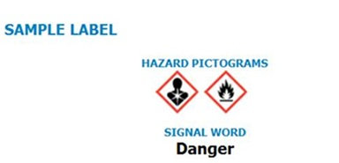
New Label Elements
Product Identifier
Signal Word
Pictograms
Hazard Statement(s)
Precautionary Statement(s)
Name, Address and Telephone Number (Contact Information)

Slide 13
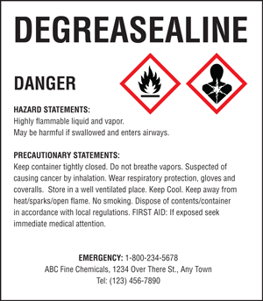
New Label Elements
Product Identifier
How the hazardous chemical is identified
Name, code number, etc.
Signal Word
Indicates the relative level of severity of the hazard
Only two words are used on the label – Danger or Warning
Notes:
Product identifier: how the hazardous chemical is identified. This can be (but is not limited to) the chemical name, code number or batch number. The manufacturer, importer or distributor can decide the appropriate product identifier. The same product identifier must be both on the label and in Section 1 of the SDS (Identification).
Signal word: used to indicate the relative level of severity of hazard and alert the reader to a potential hazard on the label. There are only two signal words, “Danger” and “Warning.” Within a specific hazard class, “Danger” is used for the more severe hazards and “Warning” is used for the less severe hazards. There will only be one signal word on the label no matter how many hazards a chemical may have. If one of the hazards warrants a “Danger” signal word and another warrants the signal word “Warning,” then only “Danger” should appear on the label.

Slide 14
New Label Elements
Hazard Statement(s) –
Describes the degree of the hazard
e.g.
  “Causes damage to kidneys through… repeated exposure when absorbed through the skin.”
  (OSHA Brief)
Notes:
Hazard statement(s): describe the nature of the hazard(s) of a chemical, including, where appropriate, the degree of hazard. For example: “Causes damage to kidneys through prolonged or repeated exposure when absorbed through the skin.” All of the applicable hazard statements must appear on the label. Hazard statements may be combined where appropriate to reduce redundancies and improve readability. The hazard statements are specific to the hazard classification categories, and chemical users should always see the same statement for the same hazards, no matter what the chemical is or who produces it. classification categories, and chemical users should always see the same statement for the same hazards, no matter what the chemical is or who produces it.

Slide 15
New Label Elements
Precautionary Statement(s):
Recommended measures that should be taken to minimize or prevent the adverse effects resulting from exposure
Four types of statements:
  Preventative (Minimize exposure)
  Response (Emergency Response, first aid)
  Storage (Proper handling)
  Disposal (Dispose in accordance with local, regional, national, international regulations)
Notes:
Precautionary statement(s): means a phrase that describes recommended measures that should be taken to minimize or prevent adverse effects resulting from exposure to a hazardous chemical or improper storage or handling.

Slide 16

New Label Elements
Pictograms
  Graphic symbols that communicate the hazard of a chemical
  GHS has nine symbols (pictograms)
Notes:
Pictogram: OSHA’s required pictograms must be in the shape of a square set at a point and include a black hazard symbol on a white background with a red frame sufficiently wide enough to be clearly visible. A square red frame set at a point without a hazard symbol is not a pictogram and is not permitted on the label. OSHA has designated eight pictograms under this standard for application to a hazard category.
How an employee might use the labels in the workplace. For example,
✓ Explain how information on the label can be used to ensure proper storage of hazardous chemicals.
✓ Explain how the information on the label might be used to quickly locate information on first aid when needed by employees or emergency personnel.
General understanding of how the elements work together on a label. For example,
✓ Explain that where a chemical has multiple hazards, different pictograms are used to identify the various hazards. The employee should expect to see the appropriate pictogram for the corresponding hazard class.
✓ Explain that when there are similar precautionary statements, the one providing the most protective information will be included on the label.

Slide 17

Flame Over Circle
Oxidizers
Example:
Hydrogen Peroxide often found in general and all-purpose cleaners is an oxidizer.
Notes:
Waxie also has grout and carpet cleaners that may contain hydrogen peroxide.

Slide 18

Flame
Flammables
Self Reactives
Pyrophorics
Self-Heating
Emits Flammable Gas
Organic Peroxides
Example:
Alcohol, commonly found in hand sanitizers and glass cleaners can be a flammable liquid.
Notes:
Some hand-held deodorizers may also be flammable.

Slide 19

Exploding Bomb
Explosives
Self-Reactives
Organic Peroxides
Example:
Ammonium nitrate, used as a fertilizer, is an example of a chemical with an explosive hazard.
Notes:
Not applicable to our product mix.

Slide 20

Skull and Crossbones
Acute Toxicity (severe)
Example:
Hydrogen sulfide, a natural occurring gas in the earth. It is
toxic if inhaled at high concentrations.
Notes:
Not applicable to our product mix.

Slide 21

Corrosion
Corrosives
Skin Corrosion/Burns
Eye Damage
Corrosive to Metals
Example:
Hydrochloric Acid, found in some bowl cleaners is a corrosive. Sodium hypochlorite, a common household bleach is corrosive to stainless steel.
Notes:
Waxie also sells strippers, e.g. W400 that may be corrosive. Oven cleaners, degreasers, disinfectants, grout cleaners, can also be corrosives.

Slide 22

Gas Cylinder
Gases under pressure
Example:
Nitrogen gas, which is used as a shield gas in gas metal arc welding.
Notes:
Not applicable to our product mix.

Slide 23

Health Hazard
Carcinogen
Respiratory Sensitizer
Reproductive Toxicity
Target Organ Toxicity
Mutagenicity
Aspiration Toxicity
  Example:
  Some graffiti removers may have carcinogens. In California, products that have Proposition 65 warning labels contain chemicals known to cause cancer, birth defects or reproductive harm.
Notes:
In the state of California a product with a Proposition 65 warning indicates possible carcinogens.
Proposition 65, the Safe Drinking Water and Toxic Enforcement Act of 1986, was enacted as a ballot initiative in November 1986. The Proposition was intended by its authors to protect California citizens and the State's drinking water sources from chemicals known to cause cancer, birth defects or other reproductive harm, and to inform citizens about exposures to such chemicals.
The following warning language is standard on products sold in California if they contain chemicals on the Proposition 65 list and the amount of exposure caused by the product is not within defined safety limits.
WARNING: This product contains chemicals known to the State of California to cause cancer and birth defects or other reproductive harm.

Slide 24

Environment
Non-mandatory by OSHA, other agencies manage
Acute Aquatic Toxicity
Chronic Aquatic Toxicity
Example:
Acids, degreasers, bleach, etc can affect water ways and marine life.

Slide 25

Exclamation Mark
Irritant (skin, eye)
Dermal Sensitivity (skin)
Acute Toxicity (harmful)
Narcotic Effects
Respiratory Tract Irritant
  Example:
  Cleaning agents have the potential to cause some irritation. Always follow directions for proper use and personal protective equipment.

Slide 26
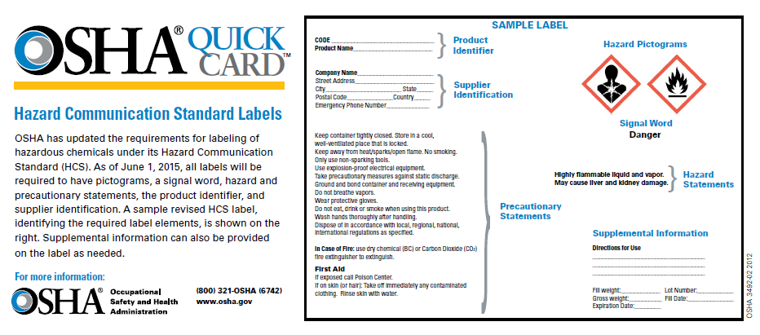
Label Example
Notes:
OSHA : www.OSHA.gov
Label- OSHA Quick Card - https://www.osha.gov/Publications/HazComm_QuickCard_Labels.html

Slide 27
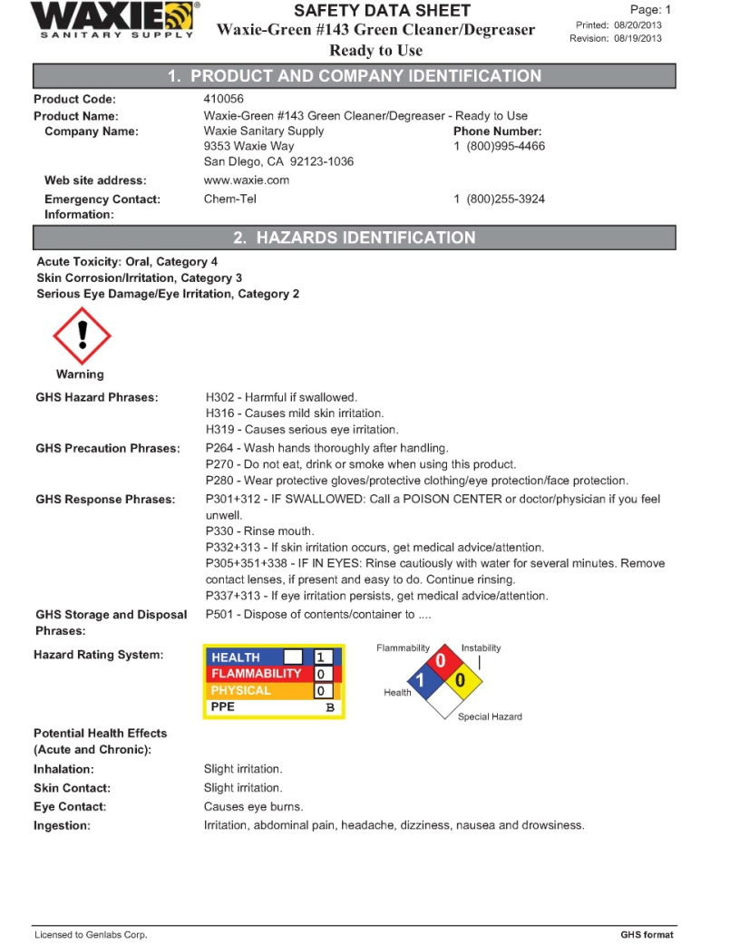
Safety Data Sheets
Material Safety Data Sheets (MSDS) will become Safety Data Sheets (SDS)
SDS new format, Standardized16 Sections
New SDS provided from manufactures and distributors by June 1, 2015
Employers must have a SDS for each hazardous chemical they use
Notes:
To align with the Global Harmonization System, SDSs must have a 16 Section format.
If there is no pertinent information in the category, it must be marked that no applicable information was found.
Employers Responsibilities:
Employers must ensure that the SDSs are readily accessible to employees for all hazardous chemicals in their workplace. This may be done in many ways. For example, employers may keep the SDSs in a binder or on computers as long as the employees have immediate access to the information without leaving their work area when needed and a back-up is available for rapid access to the SDS in the case of a power outage or other emergency. Furthermore, employers may want to designate a person(s) responsible for obtaining and maintaining the SDSs. If the employer does not have an SDS, the employer or designated person(s) should contact the manufacturer to obtain one.

Slide 28
Safety Data Sheet Format
Sections 1-8 General Information
Notes:
OSHA: www.osha.gov OSHA Quick Card - https://www.osha.gov/Publications/HazComm_QuickCard_SafetyData.html
In Section 1, IDENTIFICATION, this section identifies the chemical on the SDS as well as the recommended uses. It also provides the essential contact information of the supplier.
In Section 2, HAZARD(S) IDENTIFICATION, This section identifies the hazards of the chemical presented on the SDS and the appropriate warning information associated with those hazards.
In Section 3, COMPOSTION/INFORMATION ON INGREDIENTS, This section identifies the ingredient(s) contained in the product indicated on the SDS, including impurities and stabilizing additives. This section includes information on substances, mixtures, and all chemicals where a trade secret is claimed. the composition section relates to substances and mixtures. OSHA definitions: Substance: “A chemical element and its compounds in the natural state or obtained by any production process.” Mixture: “[A] solution composed of two or more substances that do not react.”
In Section 4, FIRST-AID MEASURES, This section describes the initial care that should be given by untrained responders to an individual who has been exposed to the chemical.
In Section 5, FIRE-FIGHTING MEASURES, This section provides recommendations for fighting a fire caused by the chemical. GHS suggests that firefighting measures include special protective equipment and precautions for firefighters.
In Section 6, ACCIDENTAL RELEASE MEASURES, This section provides recommendations on the appropriate response to spills, leaks, or releases, including containment and cleanup practices to prevent or minimize exposure to people, properties, or the environment. It may also include recommendations distinguishing between responses for large and small spills where the spill volume has a significant impact on the hazard.
In Section 7, HANDLING AND STORAGE, This section provides guidance on the safe handling practices and conditions for safe storage of chemicals.
In Section 8, EXPOSURE CONTROLS/PERSONAL PROTECTION, This section indicates the exposure limits, engineering controls, and personal protective measures that can be used to minimize worker exposure.

Slide 29
Safety Data Sheet Format
Sections 9-11 and 16 Technical Information
Notes:
In Section 9 , PHYSICAL AND CHEMICAL PROPERTIES, This section identifies physical and chemical properties associated with the substance or mixture. The minimum required information consists of the following examples. (This is not a complete list. See OSHA Brief on Safety Data Sheets for more information)
Appearance
Odor
Flash point
Viscosity
Flammability
Evaporation Rate
In Section 10, Stability and Reactivity , This section describes the reactivity hazards of the chemical and the chemical stability information. This section is broken into three parts: reactivity, chemical stability, and other.
Reactivity: Description of the specific test data for the chemical(s). This data can be for a class or family of the chemical if such data adequately represent the anticipated hazard of the chemical(s), where available.
Chemical Stability: Indication of whether the chemical is stable or unstable under normal ambient temperature and conditions while in storage and being handled.
Other: Indication of the possibility of hazardous reactions, list of all conditions that should be avoided, list of all classes of incompatible materials, and list of any known or anticipated hazardous decomposition products that could be produced because of use, storage, or heating.
In Section 11, TOXICOLOGICAL INFORMATION, This section identifies toxicological and health effects information or indicates that such data are not available. Information on the likely routes of exposure (inhalation, ingestion, skin and eye contact). The SDS should indicate if the information is unknown. Description of the delayed, immediate, or chronic effects from short- and long-term exposure. Description of the symptoms. This description includes the symptoms associated with exposure to the chemical including symptoms from the lowest to the most severe exposure. Indication of whether the chemical is listed in the National Toxicology Program (NTP) Report on Carcinogens (latest edition) or has been found to be a potential carcinogen in the International Agency for Research on Cancer (IARC) Monographs (latest editions) or found to be a potential carcinogen by OSHA includes concise and complete descriptions of various health effects and the available data used to identify the effects. The information in this section will be detailed scientific data used to determine the health hazard class and category for acute and chronic health effects.
In Section 16, date of preparation or last revision of SDS and related documents

Slide 30
Safety Data Sheet Format
Sections 12-15 are consistent with the United Nations’ Globally Harmonized System (GHS)
Notes:
In Sections 12-15: Other Agencies regulate this information, OSHA will not be enforcing Sections 12-15 (29 CFR 1910.1200(g)(2), but are included to follow GHS.
In Section 12, ECOLOGICAL INFORMATION, (non mandatory) This section provides information to evaluate the environmental impact of the chemical(s) if it were released to the environment. It is included to follow GHS, but in the United States ecological concerns will be under the jurisdiction of the Environmental Protection Agency.
In Section 13, DISPOSAL CONSIDERATIONS, (non mandatory) This section provides guidance on proper disposal practices, recycling or reclamation of the chemical(s) or its container, and safe handling practices. To minimize exposure, this section should also refer the reader to Section 8 (Exposure Controls/Personal Protection) of the SDS.
In Section 14, TRANSPORT INFORMATION, (non mandatory) This section provides guidance on classification information for shipping and transporting of hazardous chemical(s) by road, air, rail, or sea.
In Section 15, REGULATORY INFORMATION, (non mandatory) This section identifies the safety, health, and environmental regulations specific for the product that is not indicated anywhere else on the SDS.

Slide 31
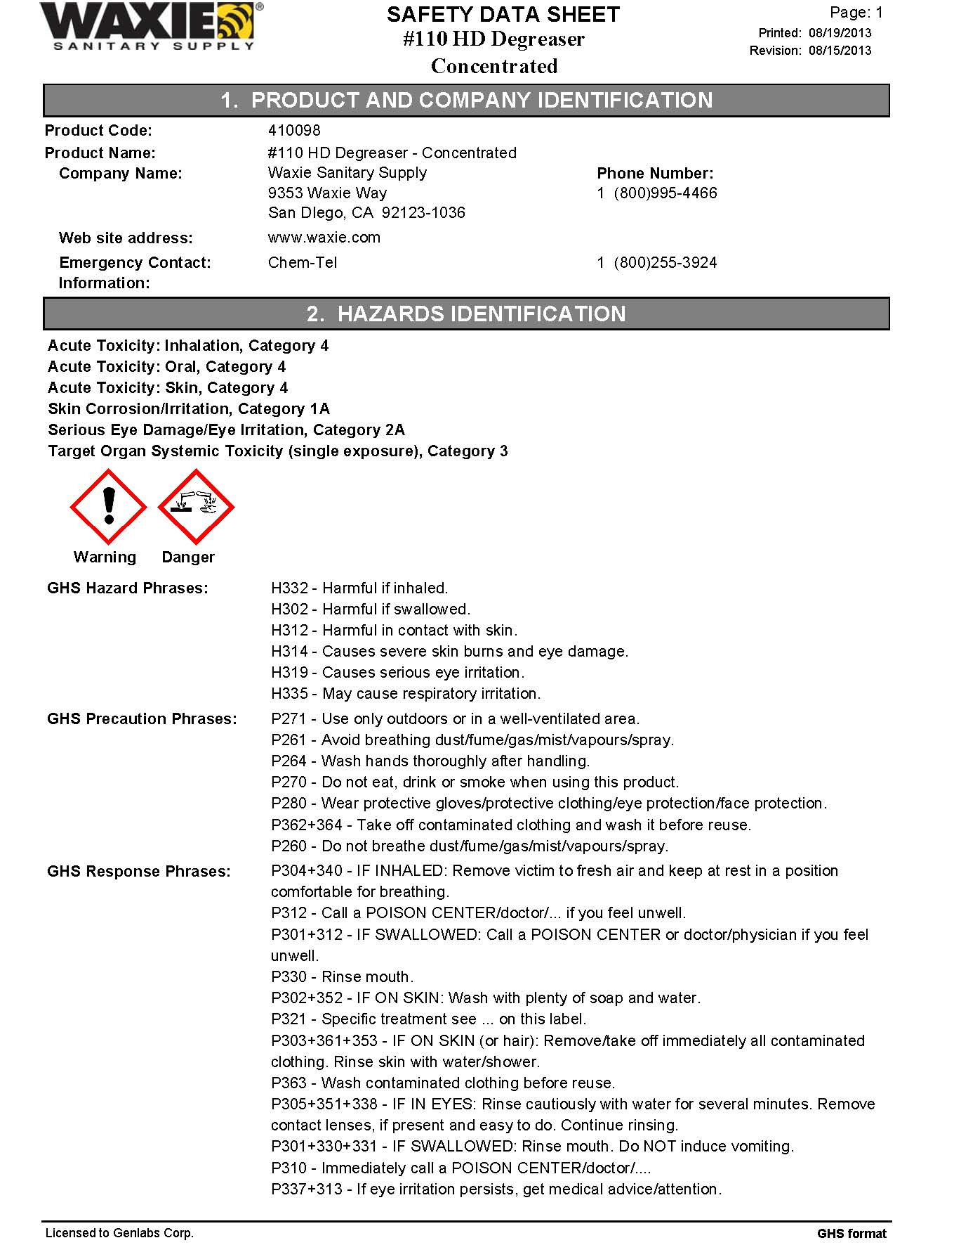
Sample of SDS
Notes:
Handout a sample of an SDS and have the class review the sections.

Slide 32
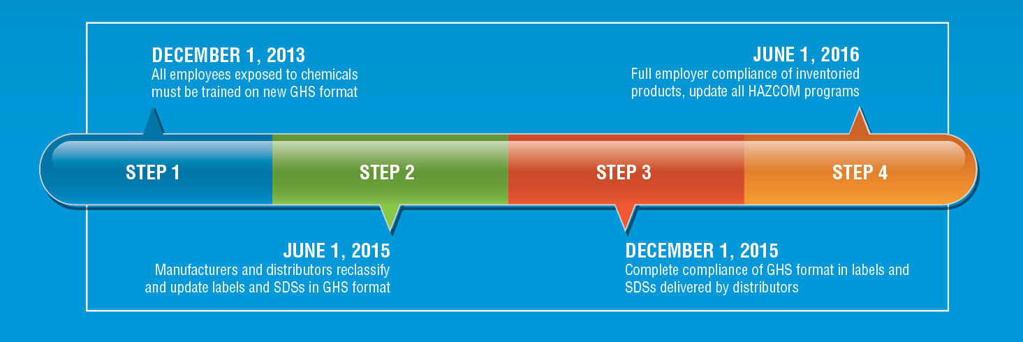
Dates to Remember
Notes:
Effective Completion Date: December 1, 2013. Requirement(s) : Train employees on the new label elements and SDS format. Who: Employers
Effective Completion Date: June 1, 2015* Requirement(s) : Comply with all modified provisions of this final rule, except: Distributors may ship products labeled by manufacturers under the old system until December 1, 2015. Who: Chemical manufacturers, importers, distributors and employers
Effective Completion Date: June 1, 2016 Requirement(s) : Update alternative workplace labeling and hazard communication program as necessary, and provide additional employee training for newly identified physical or health hazards. Who: Employers
Effective Completion Date: Transition Period Requirement(s) : Comply with either 29 CFR 1910.1200 (this final standard), or the current standard, or both. Who: All chemical manufacturers, importers, distributors and employers

Slide 33
In Summary
Become familiar with the new label elements
Replace old MSDS with the new SDS and learn where they are kept
To ensure your safety and your co-workers, be aware of the hazardous chemicals in your workplace. If you have questions ask your supervisor

Slide 34
WAXIE’s Disclaimer
    This program is based on OSHA regulations. WAXIE Sanitary Supply makes no guarantee expressed or implied. Persons using this information must make their own determination as to its suitability for their purposes in support of their own safety programs. Consult your state and local agencies for more information.
    Additional details may be available at www.osha.gov.

Slide 35
Thank you!

