Slide 1

CORONAVIRUS
Tips on Managing Stress and Anxiety

Slide 2

Tips for Managing Coronavirus
Stress
News and social media reports on Coronavirus have exploded with information.
Here are some helpful ideas for clearing your mind, staying calm and in control over all the excitement.

Slide 3
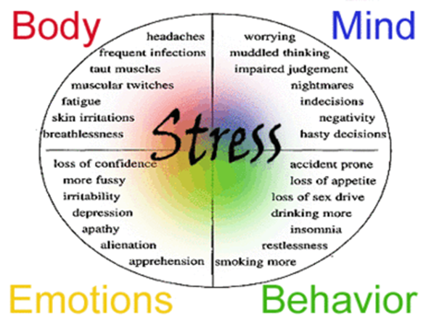
Understanding
Anxiety and Stress
Anxiety: a feeling of worry, nervousness, or unease, typically about an imminent event or something with an uncertain outcome.
Stress: a state of mental or emotional strain or tension resulting from adverse or very demanding circumstances.

Slide 4
Questions
What is Coronavirus?
How is it spread?
What are the symptoms?
How can I protect
myself from infection?
Answers
Coronavirus disease 2019 (COVID-19) is a respiratory illness that can spread from person to person.
Between people who are in close contact with one another (within about 6 feet) • Through respiratory droplets produced when an infected person coughs or sneezes.
Patients with COVID-19 have had mild to severe respiratory illness with symptoms of • fever • cough • shortness of breath
Avoid close contact with people who are sick. • Avoid touching your eyes, nose, and mouth with unwashed hands. • Wash your hands often with soap and water for at least 20 seconds. Use an alcohol-based hand sanitizer.
Sources you can trust:
https://www.who.int/
https://www.cdc.gov/

Slide 5

Limiting your information to facts
It is easy to get caught up in the frenzy. You have the power of control in your hands. Trusting the sources that you rely on for your information.
Keep it simple.
Sources you can trust:
https://www.who.int/
https://www.cdc.gov/

Slide 6
Safe Space
What does this feel like to you?
Here are a few ideas to help you set up a comfortable place for you to balance.
A HAPPY PLACE
Taking a walk, laying in the grass, listening to nature.
Creating a meditation space that includes your favorite colors, music, pictures and fabrics.
Rest, do a meditation on calm.com
Start a fun project such as pottery, building a birdhouse, painting or music video.
Talking or Skype with family & friends.
Self care is so important. Take a break from the news and listen to a funny podcast, treat yourself to a fancy coffee, get a massage.
You are amazing and deserve it!

Slide 7

Know when you need extra support
We are here for you!
It is not easy to ask for help sometimes.
We have a limit to what we can handle. If you have found that nothing is helping to alleviate your worry, you have options.
Counseling Center hours:
Monday - Friday 8 am to 5 pm
Closed during Spring break
Health Center - 24 hours a day, 7 days a week
Spring break hours 9-12am
FOR MENTAL HEALTH EMERGENCIES
Call 911
Contact your resident director
Campus Security (509) 527-5777
Walla Walla Crisis Response (509) 524-2999

Slide 8

A Place Like No Other
Here at Whitman we are a community.
As a community we support your Health and Safety. During times of heightened stress and challenging emotions, we must trust our mental strenghth and confront our fears with care.
The Counseling Center is here and you are not alone.

