Slide 1
WEB TIMESHEETS
Mindy Neissl
Accounting Coordinator
(509) 527-5130 or neisslmm@whitman.edu
Notes:
I’m Mindy Neissl and I take care of all student payroll.
So long story short, just call me, email me or stop by Mem 110 to see me if you have any questions.

Slide 2
STUDENT PAY PERIOD INFORMATION
The student pay period runs from the 9th of a month to the 8th of the following month (example May 9th thru June 8th)
The cutoff for entering and approving time in web timesheets is 1.5 business days after the 8th.
Faculty should require their student workers to enter and submit all hours worked for the pay period no later than the 9th of the month. This allows the faculty time to review and to reject timesheets for correction, if necessary.
Students and faculty will not have access to the new pay period’s timesheet until I have completed processing payroll. Generally, there is no access between the 10th and the 18th.
Because of this, students and faculty should keep track of hours worked separately in order to be prepared for entering hours in their web timesheet once they are open.
Notes:
The student pay period runs from the 9th of a month thru the 8th of the following month. So the upcoming pay period is from May 9th through June 8th.
The system locks users out 1.5 business days after the 8th. Faculty will receive an email each month letting them know the cutoff dates, as they change slightly depending on what day of the week the 8th falls on.
Faculty should require students to have all hours submitted as quickly as possible. Faculty are not allowed to make any changes to the timesheet, so if an error is found, it must be rejected back to the student to fix and to resubmit.
When I am processing the payroll each month, there is no access to the next pay periods timesheet. This is generally between the 10th & 18th.
Because of this, students should log their hours separately to keep accurate track of hours worked. Faculty should track student hours, as well, so they can verify that the hours submitted are accurate.

Slide 3
TRACKING HOURS - STUDENT RESPONSIBILITIES
Students may not work overtime. It is the student’s responsibility to track hours to ensure they do not go into overtime.
Overtime is defined as more than 40 hours in a week.
All hours worked in all jobs are included in # of hours worked in a week.
A week is defined as any hours worked between Sunday at 12:00 am to Saturday at 11:59 pm.
Hours for the week do not start over if the pay period
ends in the middle of a week.
Notes:
Students may not work Overtime
Overtime is any hours worked over 40 hours in a week
Our week, for payroll purposes, runs from 12:00 am on Sunday to 11:59 pm on Saturday
Even if the pay period ends mid-week, we still cannot go over 40 hours between Sunday & Saturday
SUPER IMPORTANT - If you have more than one job at Whitman, you have to take into account the hours worked for all jobs when making sure you do not go over 40 hours/week

Slide 4
TRACKING HOURS –
FACULTY RESPONSIBILITIES
Faculty are responsible for reviewing and approving all student timesheets.
There will be an alternate supervisor set up in case the faculty member does not have access during the end of the pay period. Division/Admin Assistants will be the alternates in most cases. Tana Park will be the alternate for NSF, Murdock and other external grants.
Faculty should communicate, well in advance, to their alternate any times when they will need them to approve timesheets.
Notes:
Faculty must review and approve all student timesheets each month
Alternate supervisors are set up for each position – generally it will be the Division or Admin Assistants, it could be Qi on the Provosts office, or Tana Park with Grants
If a Faculty member will be away and unable to access timesheets during the cutoff period, they will need to let their alternate know in advance so they can be prepared to do it for them

Slide 5
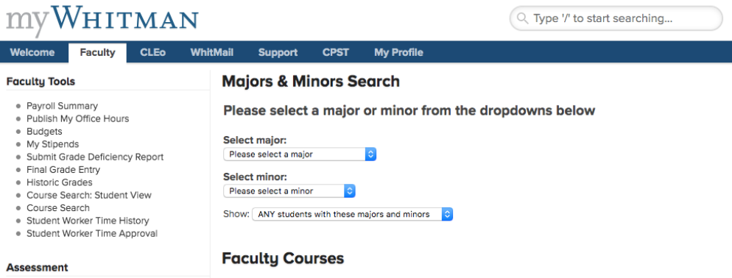
FACULTY INSTRUCTIONS #1
Click on Student Worker Time Approval
Notes:
Okay, now on to Web Timesheet
You get to Web Timesheets through your myWhitman
Here is the Faculty myWhitman screen
Faculty will click on Student Worker Time Approval

Slide 6
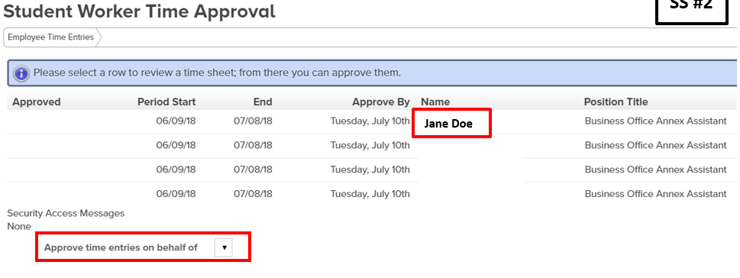
FACULTY INSTRUCTIONS #2
Click on Name for the student you want to review
Notes:
This brings you to the list of students.
You will click on the name of the student you want to review.

Slide 7
FACULTY INSTRUCTIONS #3
If you want to know a student’s sick leave balance, you can see it on the top of their Web Timesheet.
Overtime is figured based on all jobs. This is not something you can change.
Notes:
On the top of their timesheet, you will see the students sick leave balance.
This screen also shows you the regular & sick leave hours the student submitted.
If there are any overtime hours listed, these cannot be changed by Faculty as they are automatically figured based on all hours submitted for all jobs.
Feel free to contact me about this….if not, I will be in contact with you when I am processing payroll to ensure the right department is charged.

Slide 8
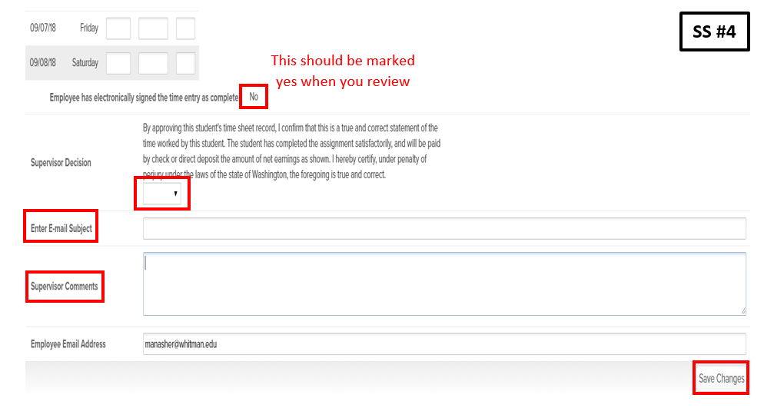
FACULTY INSTRUCTIONS #4
Enter Supervisor Decision.
If you reject it, complete email information.
Notes:
Once you review the hours submitted, you will either approve or reject them – do this by using the drop box by Supervisor Decision
If you approve the timesheet, then just click on SAVE CHANGES
If you reject the timesheet, you will need to fill in the email subject and comments sections. Be sure to give enough information to let the student know what they need to do to fix the timesheet – then you will click on SAVE CHANGES
Once you click on SAVE CHANGES, it automatically sends an email to the student

Slide 9
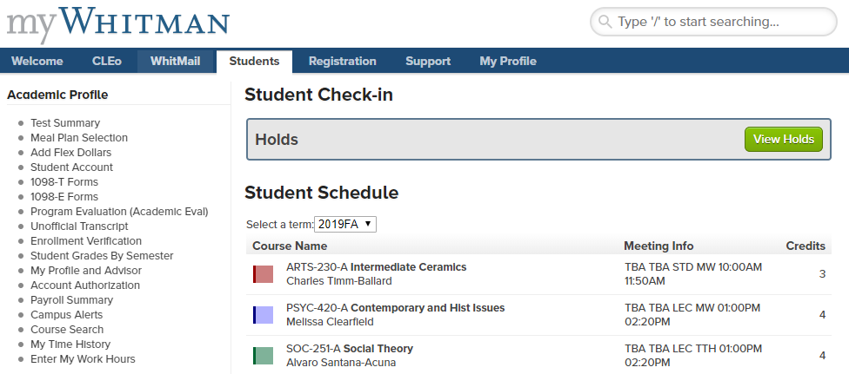
STUDENT INSTRUCTIONS #1
Click on Enter My Work Hours
Notes:
Quickly – here is what the student myWhitman screen looks like
You will click on Enter My Work Hours

Slide 10
STUDENT INSTRUCTIONS #2
Click on the Position Title for the job you want to enter hours for.
Notes:
Here, be sure to click on the correct job for the hours you want to enter
We have a lot of students that enter hours into the wrong job

Slide 11
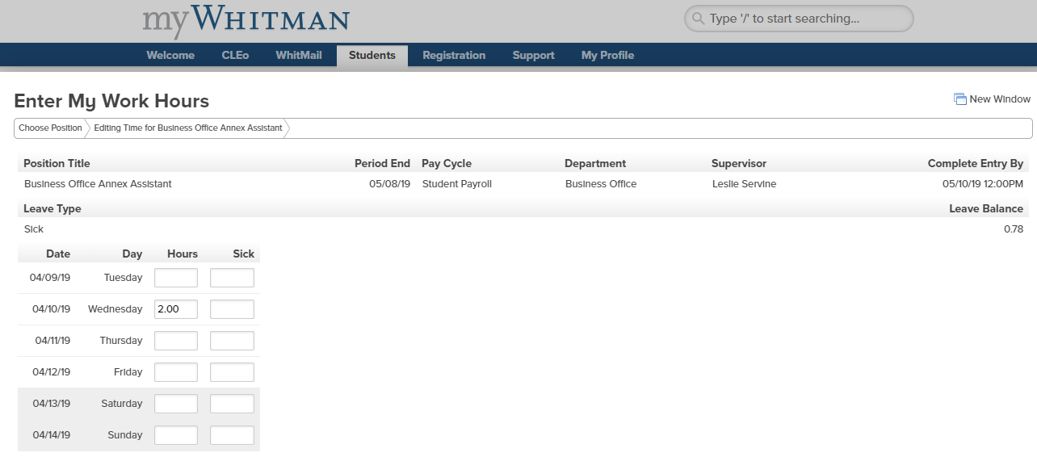
STUDENT INSTRUCTIONS #3
Sick leave balance is listed on the top of the Web Timesheet.
Add in hours worked and sick leave used for each day you worked during the pay period.
Notes:
This screen shows your sick leave balance
This screen is where you add your regular hours worked and any sick leave you are approved to use

Slide 12
STUDENT INSTRUCTIONS #4
When entering hours prior to the end of a pay period, click on SAVE CHANGES.
Once you are ready to submit hours at the end of the pay period, click on the box for your electronic signature and then click on SAVE CHANGES.
Notes:
During the month, when you enter hours, click on SAVE CHANGES to save them
At the end of the pay period, when you want to submit your hours to your Faculty member for approval, click on the box and then click SAVE CHANGES
This automatically sends an email to your Faculty

Slide 13
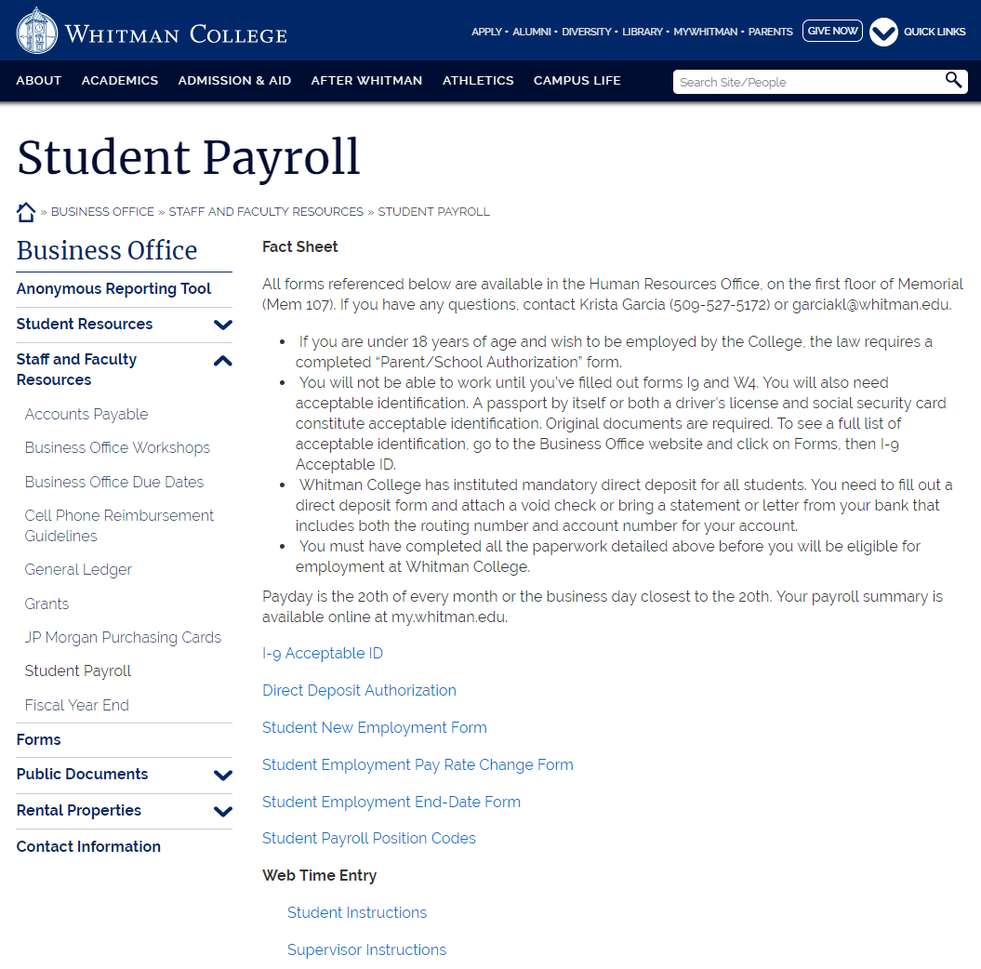
WHERE TO FIND STEP-BY-STEP INSTRUCTIONS:
Notes:
I know that was a very quick overview, but there are step-by-step instructions for the Web Timesheet process for both supervisors and students
You can find these instructions on our Business office website
You can click on Student Resources or Staff and Faculty Resources – for both click on Student Payroll and you will find the instructions out of Web Time Entry
And remember, you can always call, email or stop by to see me with any questions

