Slide 1
JPMC WORKSHOP

Slide 2
STATEMENT & DOCUMENTATION
Always have the statement on the front
Followed by the JPMC Documentation Form
Eventually we will be rolling out the form that is used by the Provosts office so that all will be using the same form
Followed by the back up for all purchases made – we must have receipts for all purchases now.
This is followed by any receipts from the Cashier’s office for any returned cash.
All must be stapled together, at the top left corner. If you cannot staple it, please use a binder clip – NO PAPERCLIPS PLEASE!

Slide 3
Why is Mindy so picky you ask???????
***THIS IS WHY***

Slide 4
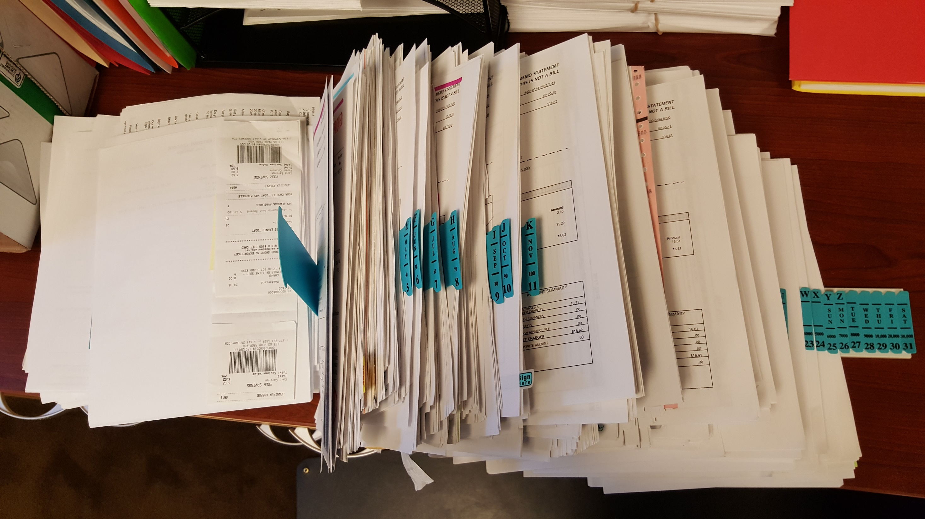
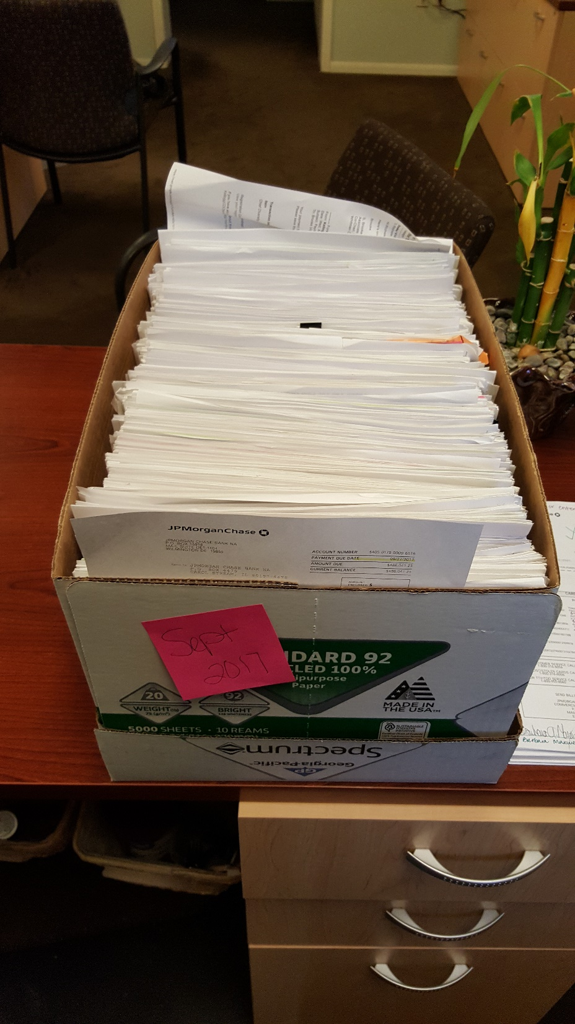
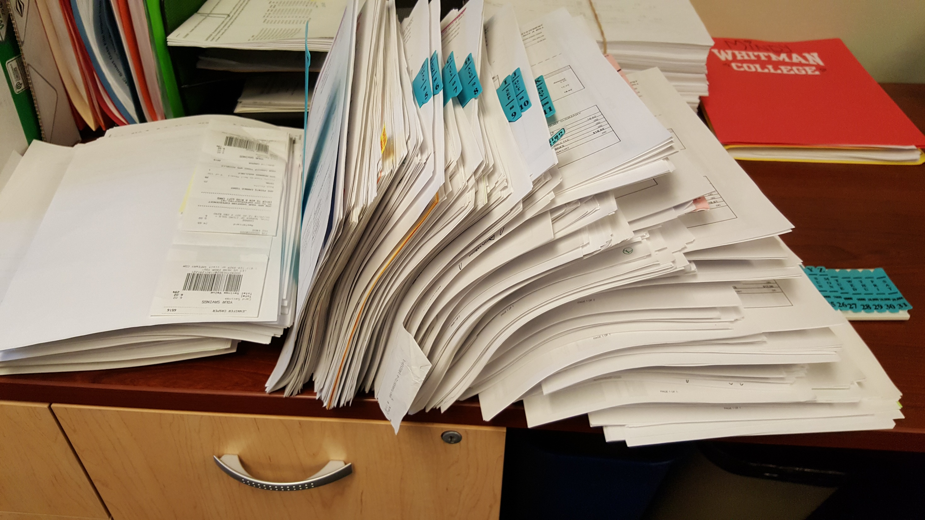
404

Slide 5
JPMC DOCUMENTATION FORMS & SIGNATURES
Must have a JPMC Documentation form attached if there are any purchases for travel, entertainment or food/coffee of any kind. All of these types of purchases must have a signature by a cabinet officer.
Also, any purchases of $5000 or over, must have the additional cabinet officer signature.

Slide 6
BUSINESS PURPOSE
We must have the “business purpose” for each purchase.
When there are meals or food purchases, each purchase needs the following:
Business Purpose
Number of Participants
And, if the number of participants is under 10, the names of each participant

Slide 7
MISCELLANEOUS
PERSONAL USE OF THE COLLEGE CREDIT CARD IS PROHIBITED
CASH ADVANCES SHOULD ONLY HAPPEN ON RARE OCCASIONS DURING INTERNATIONAL TRAVEL
IF SOMEONE HAS A COLLEGE CREDIT CARD THEY SHOULD USE IT FOR COLLEGE PURCHASES AND NOT USE THEIR OWN CARD & THEN GET REIMBURSED.
TRAVEL INSURANCE
PAYPAL – VENMO – ETC.

Slide 8
SMART DATA & USE TAX
Questions about Sales Tax/Use Tax????? Does everyone understand this?
Check to see if sales tax has been charged. If it has not been charged and it should be, you must mark this to be added in Smart Data.

Slide 9
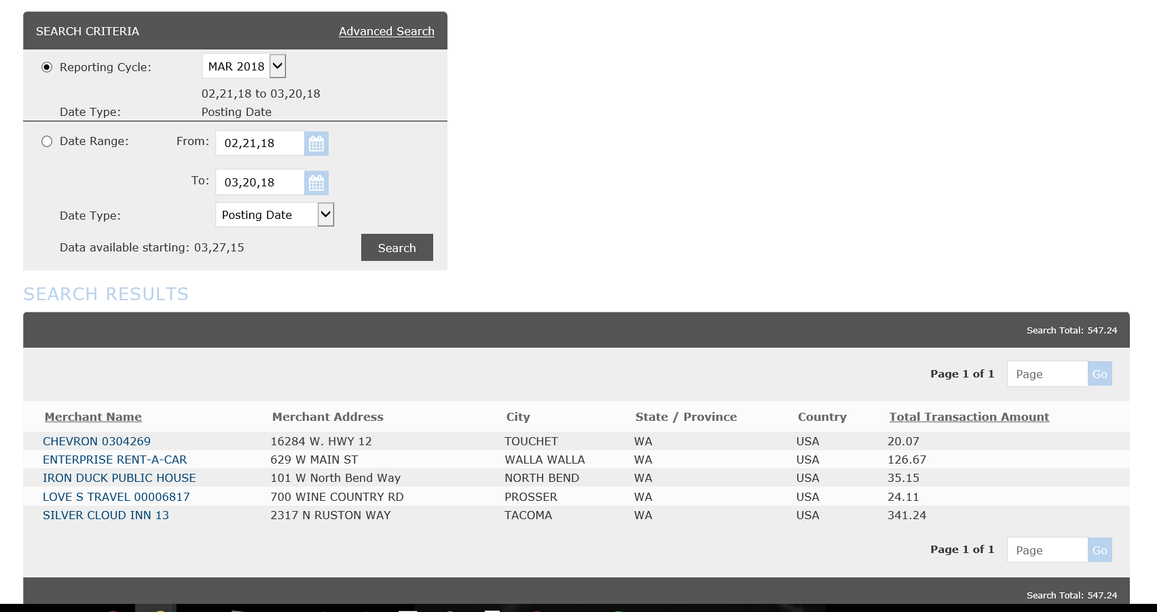
Go into Smart Data
Click on the Financial tab
Click on Merchant Summary
Search by Name
Pick the Reporting Cycle and it will bring you to this screen
From here click one of the merchants below

Slide 10
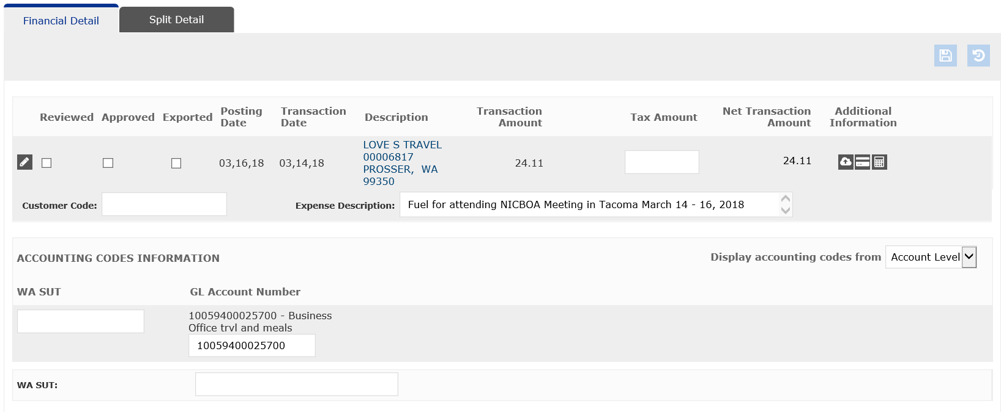

Slide 11
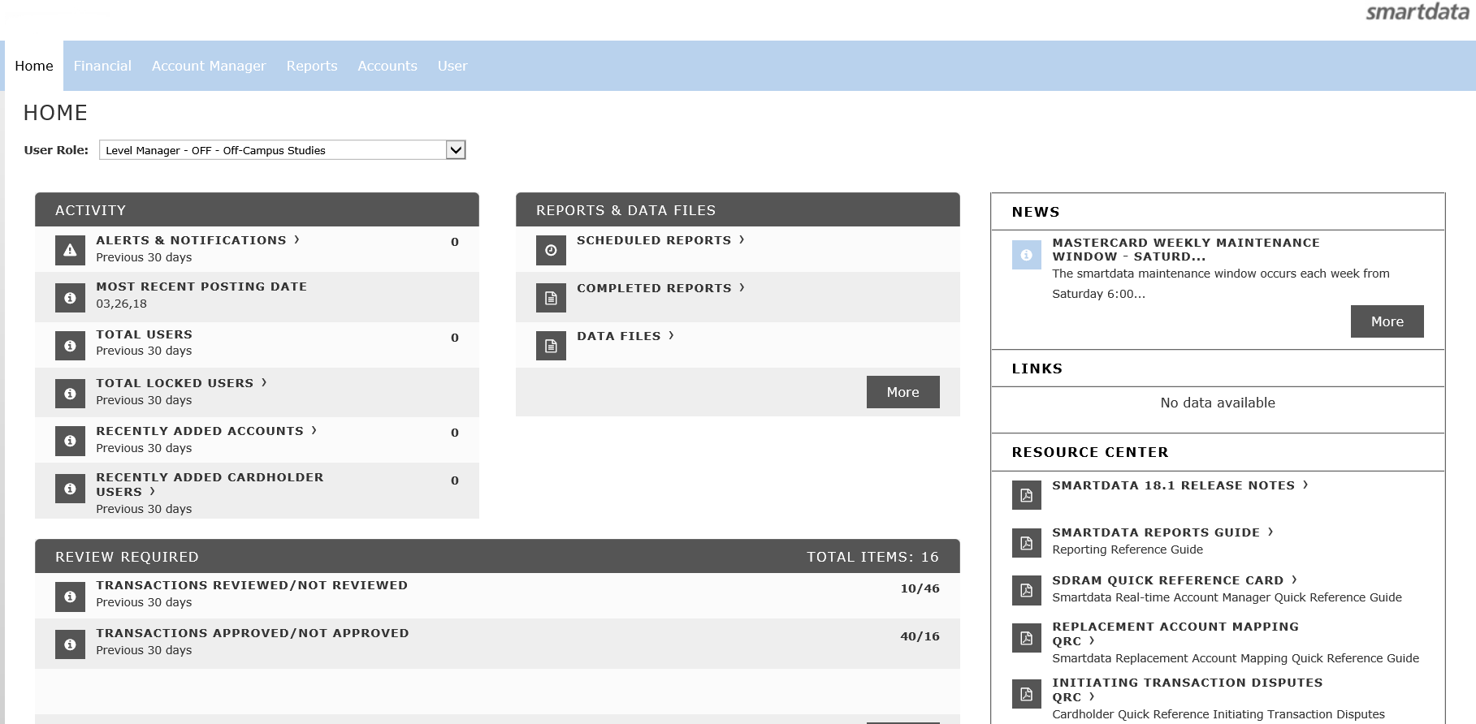

Slide 12
QUESTIONS???
If we can get these few things streamlined, we can have more time to work on improvements (i.e. scanning of receipts into Smart Data, etc.)

