Slide 1
Jpmc compliance training
January 2020
Mindy Neissl, Accounting Coordinator
Business Office Annex

Slide 2
Smart data information:
You should input information into Smart Data as you get the receipts from your cardholders. Do not wait to enter all this information at the end of the pay cycle.
When sales tax is already charged, make sure it is marked in Smart Data.
What needs Use Tax and how does that get entered in Smart Data?
A great example of how to format the description field in Smart Data.

Slide 3
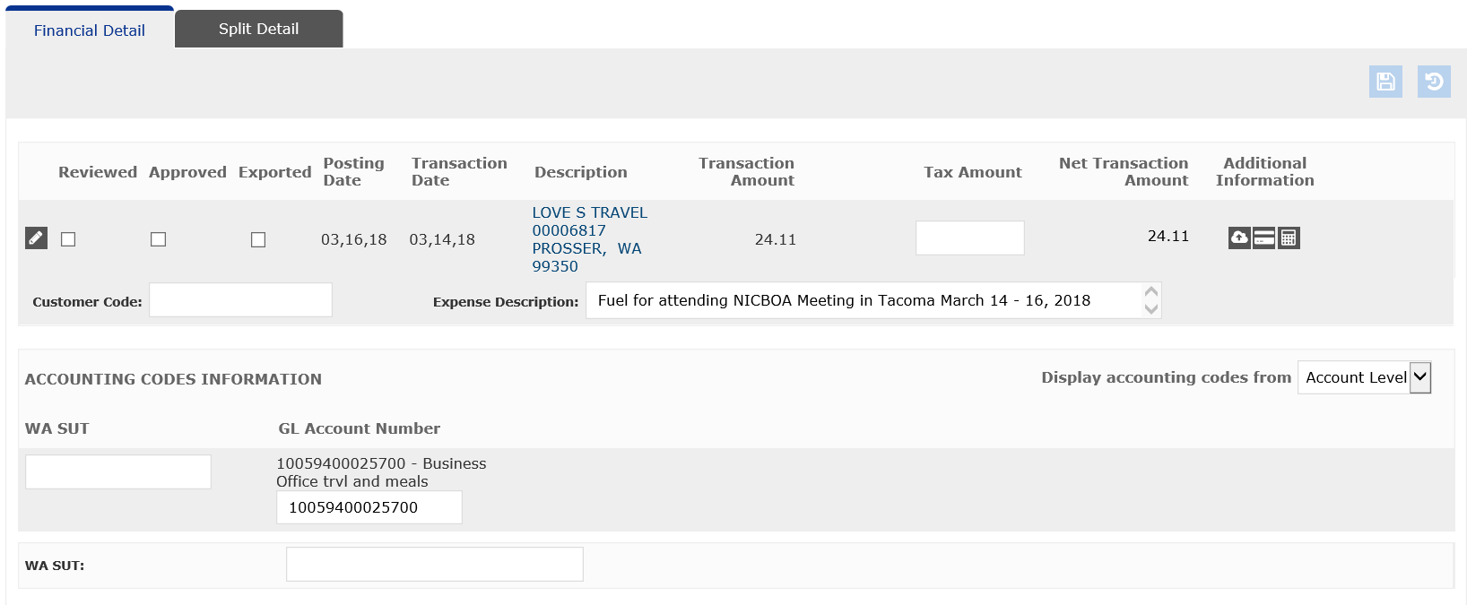
If there is tax charged on the receipt and it is not listed here, then add it
If there is no tax listed on the receipt and this is a charge that should be taxed, please put a “Y” in this WA SUT box – not the one below it.

Slide 4
Business Purpose, Where, When, What, Tax Info if necessary – see examples below
NICBOA Conference – Tacoma, WA – March 14-16, 2020 – fuel charge – no tax charged on receipt
Supplies for office – no items were consumable – tax on receipt
Book for research – no tax charged on receipt
Local meal – Director Candidate, meal with department – 4 attendees (Kazi Joshua, Juli Dunn, Bridget Jacobson, candidate) – tax and tip on receipt
Here is where you change the GL account number if it should not be taken from the default GL account. Type slowly. Double check the account information after you save it.

Slide 5
forms
JPMC Documentation Form:
The Preparer (that is you), must sign the form as verification that all receipts are attached.
Signatures of the Card Holder and the Department Head are mandatory.
Need the signature of the Cabinet Officer if there are any TME items or any individual item that is over $5,000.
Info on Trips and Local Meals must be included on the top of this form.
Info on any Cash Advances taken must be included on the top of this form.

Slide 6
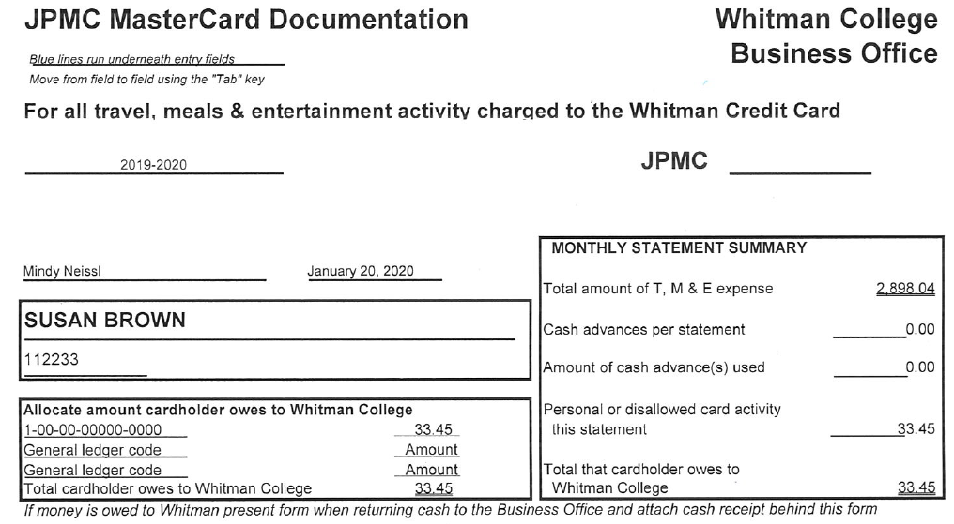
Here the card manager puts their name & initials by it that all receipts are attached
This amount should be your statement total & is automatically figured
Statement date - please
Here you need to enter the GL account and amount of each personal charge that needs to be reimbursement – the total amount here is the amount of the reimbursement receipt that should be attached
This is the total of all personal reimbursement amounts charged to this month’s statement

Slide 7
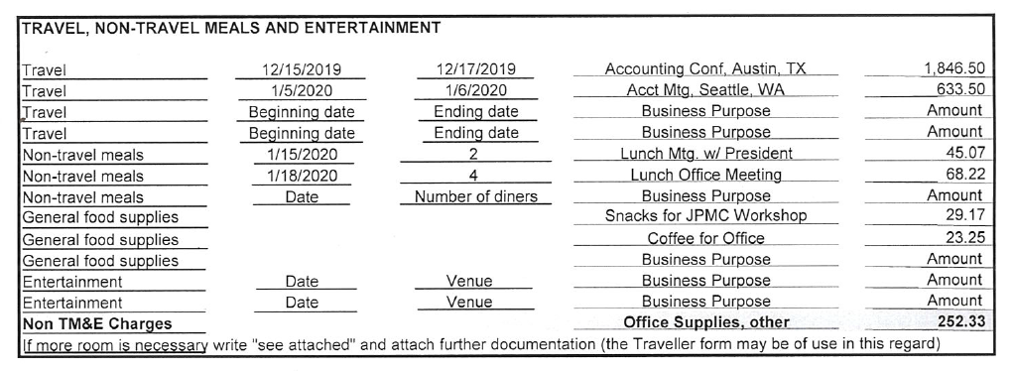
Look over this part of the form carefully & ask any questions that you have.
All charges on the statement should be represented on this part of the form.

Slide 8
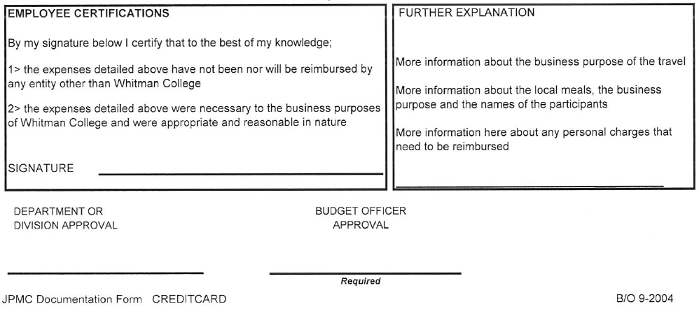
The card holder must sign this certification – if you cannot get a card holder to come over in person to sign, you can get an email from them, but it must have this verbiage in the email.
This section should always be used to give more information as listed:
This form must be signed by a department head, if there is one. The Cabinet Officer must sign this form if there are TME charges and/or an individual charge of $5000 or more.

Slide 9
This is the part of the form that you will need to complete. The name, dept and the rest of the form not shown is automatically filled in with information from Smart Data
Expenses verified by is where you should type your name and the date. Once you print it off, you should sign or initial next to it the typed name. You are verifying that all receipts are attached.
In this box, the top total should match the total of your statement.
Cash advances should be placed here.
Personal reimbursement amounts should be placed here
Same as the other form – the card holder must sign the Employee Certification, the department head must sign approval, and the Cabinet officer must sign if there are any TME charges and/or any individual charge over $5000
In this box, you need to put the total amount and information for each trip; and, information for each local meal to include # of attendees

Slide 10
Documentation packet
The Statement or the JPMC MasterCard Documentation form can be on top.
We go off of the statement when we are reviewing the documentation, so all receipts must be in order based on the order of the charges on the statement.
All receipts must match the amount of the charge on the statement.

Slide 11
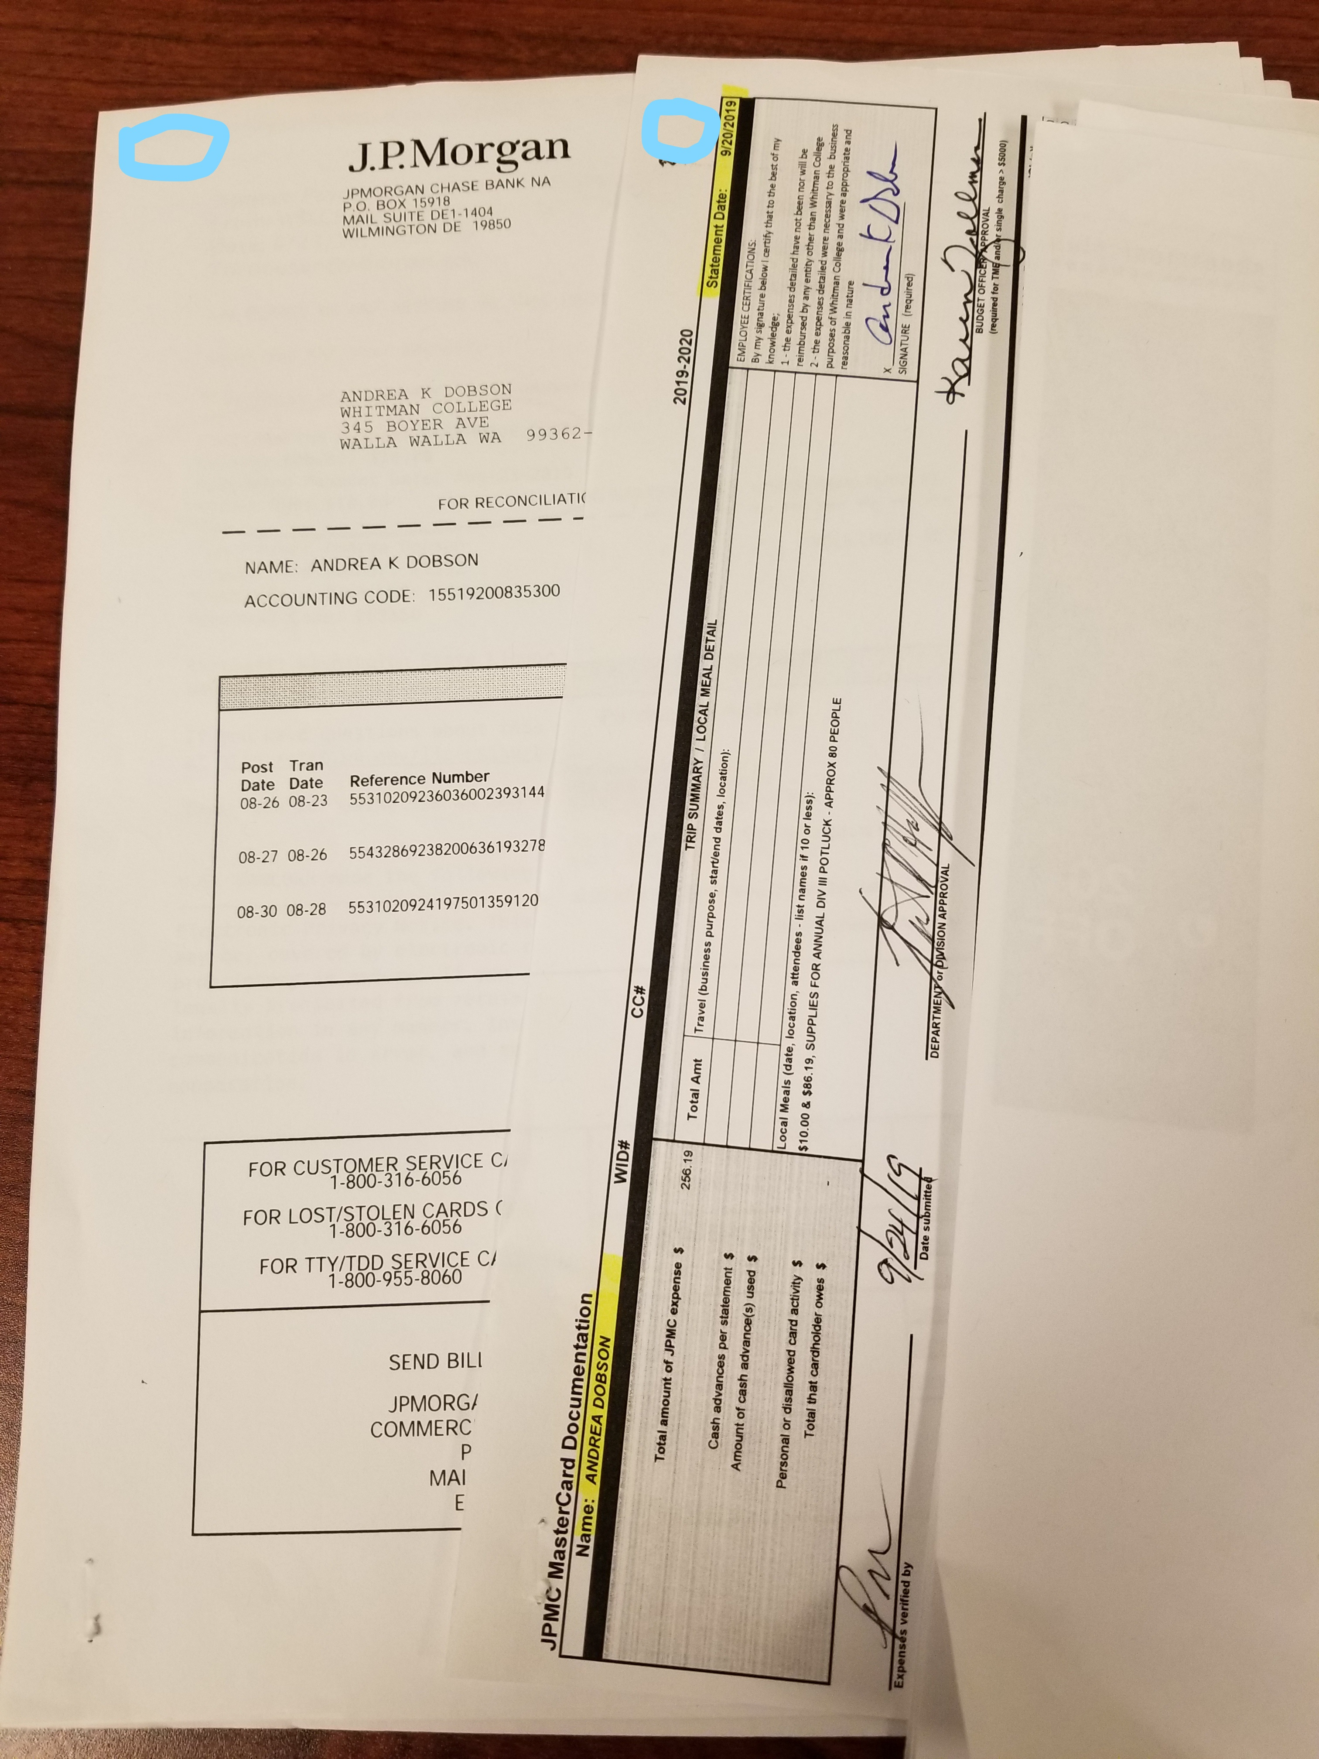

Slide 12
Documentation packet (cont’d)
Needs the business purpose for each charge (why should Whitman pay for this?).
Need the # of diners for each meal charge (our office requires names for 5 or less – other departments have different requirements).
Need an itemized receipt for every charge.
Need to check to see if tax has been or needs to be charged.

Slide 13
MISSING RECEIPTS
Process for Missing Receipts:
Contact the card holder to ask about missing receipt.
If they do not have it, request that the card holder contact the company and try to acquire a duplicate receipt.
If the card holder is unable to acquire a duplicate receipt from the company, they must complete & sign an email/memo.

Slide 14
Memo of missing receipt
The memo or email of a missing receipt must be attached to the JPMC documentation packet.
The following are the information that must be on this memo:
The date of the purchase & the company purchased from.
The amount of the purchase & items that were purchased.
The business purpose of the purchase (why should Whitman pay for this?).
Why the receipt was lost and why a duplicate receipt could not be acquired.

Slide 15
timeframes
All information for Smart Data (descr, gl acct, use tax info) must be input by the 5th of the month following the statement date.
All JPMC document packets must be to my desk (with all signatures) no later than the 5th of the month following the statement date.
WHY?
I must review all transactions and ensure use tax has been charged appropriately.
If there is no information in the description and I do not have a statement to check, I will charge use tax on all charges that should have tax charged.

Slide 16
MORE SPECIFICS
PERSONAL USE OF THE CREDIT CARDS IS PROHIBITED.
PLEASE DO NOT USE PAYPAL OR VENMO TYPE SERVICES.
WHEN TAXES ARE CHARGED SEPARATELY, MAKE NOTE OF THIS ON THE DESCRIPTION LINE FOR BOTH THE PURCHASE AND FOR THE TAX CHARGE.

Slide 17
More specifics
NO PAPERCLIPS, PLEASE!
NO MORE ENVELOPES WITH RECEIPTS!
NO EXTRA PAPERWORK PLEASE!

Slide 18
How to run a report
Go to Smart Data – Hover over the Report Tab - Click on RUN
1. Reporting Entity – Whitman College
2. Report Name – click on My Exports, then click on Custom
3. Criteria – Date Type=Posting, Review Status=All, Financials to Include (see below)
If you run this before I pull the transactions, choose Non-Exported Financials
If you run this after I pull the transactions, choose Previously Exported Financials
Report Notes – give the report a name
DO NOT click on SET FINANCIALS EXPORT FLAG
4. Frequency – Reporting Cycle, use drop down to click on the appropriate reporting cycle that you want information from
5. Delivery Options and Notifications – this is already set up with your email address
SUBMIT REQUEST

Slide 19
RESPONSIBILITIES
SARA FREY – new cards, suspending/closing an account, ordering a new card, limit changes, default GL account, charge disputes.
SUSAN BROWN – besides the fact that she is responsible overall for JPMC credit cards, she is also responsible for reviewing and approving all missing receipt memos.
MINDY NEISSL – Smart Data issues, monthly import of transactions, review of use tax information, review of all JPMC documentation packets.

