Slide 1
Fiscal Year-End Procedures
FYE June 30, 2016

Slide 2
Year end process
BUDGET VS.
FINANCIAL
STATEMENTS

Slide 3
Year End Process
Cash Method of Accounting:
All costs (services and supplies) are recorded when the voucher is entered into Colleague
Can be used for budget purposes
Accrual Method of Accounting:
All costs (services and supplies) are recorded when received or “placed into service”
Required for financial statements

Slide 4
Year end process
The most important point to remember is all expenses should be recorded in the year they were received. (Accrual method)
-For example, supplies ordered in June but received in July should be recorded in the next fiscal year.
Expenses occurring close to year end can be posted differently if necessary for budget purposes. (Cash basis method)
-For example, expenses that were delayed for some reason and received in July but the current year budget needs to be charged.

Slide 5
Payroll
Remember – all payroll expenses through June 30th need to be recorded in the current fiscal year.
Faculty and salary payroll are paid on a monthly basis for the calendar month so there is no timing difference adjustment for their salaries through June 30th.
Hourly staff are paid on a 21st through the 20th pay period. Although hourly staff won’t be paid for the period of June 21st through June 30th until July, we need to record those hours as of June 30th.
Student employees are paid on a 9th through the 8th pay period. Although students won’t be paid for the period of June 9th through June 30th until July, we need to record those hours as of June 30^{th.}

Slide 6
Payroll - continued
The Business Office (Kellie) computes all of the payroll accruals based on actual costs.
YOU WON’T NEED TO DO ANYTHING!!!
Just be aware there will be additional payroll and OPE charged to your budgets if you have hourly or student employees.
If you have an “unusual situation”, please let us know.

Slide 7
Year End JPMC P-Card Transactions
Expenses will be posted based on the transaction date UNLESS the supplies were received after June 30^{th.}
There will be no need to stop using the cards to ensure expenses get recorded in the correct year.
Invoices for supplies should have the date received on them.
Travel will be posted on the SmartData transaction date no matter when it occurs.

Slide 8
Paying Invoices (Voucher entry)
Dates are important in two places for fiscal year end closing:
Voucher Date
Invoice Date
Do not automatically use current date (default) as VOUCHER DATE when entering vouchers in VOUM
Invoice dates are VERY important when entering vouchers after June 30.

Slide 9
VOUCHER DATE
For vouchers entered prior to July 1st - Use current date when paying for goods and services already received.
For vouchers entered July 1st through July 15th, use June 30th for VOUCHER DATE for goods and services received in June BUT use the current date for goods and services received in July.
For vouchers entered after July 15th, use the current date. If you receive an invoice after July 15th that is for the prior year (prior to July 1st), please flag that invoice or vendor payment with a post-it note or flag or contact Susan Brown. These invoices will be charged to the year they are entered unless you contact us.

Slide 10
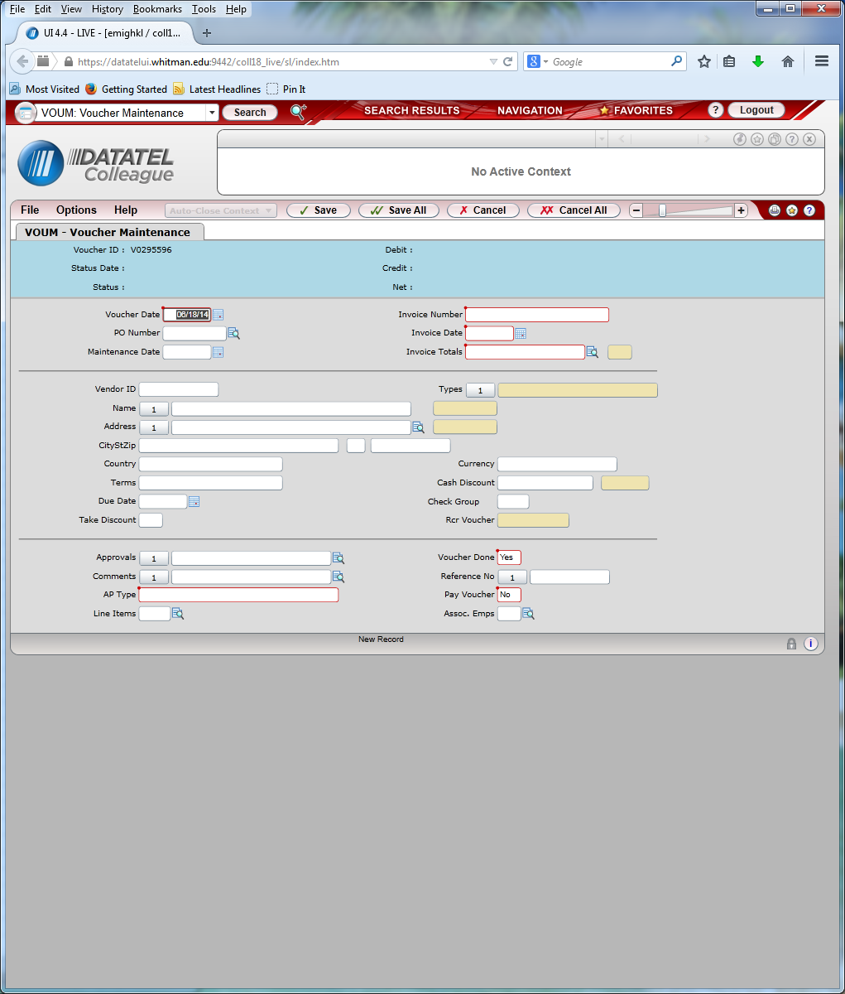
Paying Invoices (Voucher entry)

Slide 11
INVOICE DATE
Enter the invoice date as the date the goods and services were provided. This is especially important after June 30th.
The invoice date is used to search for goods and services that were received in the prior fiscal year but paid for after the end of the year (unrecorded liabilities).
Beginning now, please list the date received on invoices for supplies. You can also include packing slips with the invoices. Again, please note on the packing slip the actual date of receipt.

Slide 12
Journal entries/vendor payments/tme’s
Vendor payments and TME’s for the current year should be completed and entered into Colleague by July 15th. They do not have to be paid by July 15th but they do need to be entered into the system. If you find something after that, please contact the Business Office.
All journal entries should be submitted to the Business Office by July 15th.
Signers should use the date they are signing, not the date the entry should be booked.

Slide 13
Service Department Charges
All interdepartmental charges for the current fiscal year (through June 30th) need to be submitted to payables@whitman.edu no later than the 10th of July.
If you can’t meet this deadline, contact us.

Slide 14
Petty Cash
Petty cash should be replenished (a vendor payment completed and a check received) prior to year end so the expenses are booked in the correct year.

Slide 15
Personal Reimbursements
For current year expenses prior to June 30th, cash requests can be taken to the Student Accounts Business Office (Memorial Room 233) for cash.
After June 30th, submit these requests to Accounts Payable for a check.

Slide 16
Travel Advances
All outstanding travel advances given for travel in the current fiscal year (ending June 30th, 2015) need to be reconciled and submitted to Mindy no later than July 15th, 2016
If a travel advance is needed for travel occurring after June 30th, contact us for the correct General Ledger account number to use (If needed prior to July 1st)

Slide 17
New object codes
5341 – Computer Software/Services: To be used for software purchases, including service/maintenance agreements and licensing fees.
5342 – Computer Software over $10,000: To be used for purchase of software over $10,000. Not used for service/maintenance agreements or annual licensing fees.
5343 – Info/Tech Equipment under $10,000: Mainly used by SCTS for information and technology equipment like fax machines, routers, gateways, etc.
5344 - Info/Tech Equipment over $10,000: Mainly used by SCTS for information and technology equipment like fax machines, routers, gateways, etc.

Slide 18
New object codes Continued.
5511 – Computers under $10,000: Individual computers under $10,000 including laptops.
5512 - Computers over $10,000: Individual computers over $10,000 including servers.
5518 – Computer Maintenance/Repairs: Mainly used by WCTS for computer repairs and maintenance including supplies purchased for internal repairs.
5519 – Telephone Equipment: To be used for cell phones and other phone equipment.

Slide 19
The End!
Communication is the most important element to ensure year-end reporting is correct. Please ask questions if you are not sure. Expenses can usually be charged to the budget year you choose if we know your intent.
All feedback and suggestions are welcome – we need your input to continue to improve this process.

