Slide 1
Fiscal Year-End Procedures
FYE June 30, 2015

Slide 2
Year end process
BUDGET VS.
FINANCIAL
STATEMENTS

Slide 3
Year End Process
Cash Method of Accounting:
All costs (services and supplies) are recorded when the voucher is entered into Colleague
Can be used for budget purposes
Accrual Method of Accounting:
All costs (services and supplies) are recorded when received or “placed into service”
Required for financial statements

Slide 4
Year end process
The most important point to remember is all expenses should be recorded in the year they were received. (Accrual method)
-For example, supplies ordered in June but received in July should be recorded in the next fiscal year.
Expenses occurring close to year end can be posted differently if necessary for budget purposes. (Cash basis method)
-For example, expenses that were delayed for some reason and received in July but the current year budget needs to be charged.

Slide 5
Payroll - formerly (The Old Way)
Hourly Staff: Project hours for each employee for June 21-June 30.
Student Employees: Project hours for each student for June 9-June 30.
Use the Excel sheets sent to you with the Year-End memo, as they self total.
If overtime hours are expected, please note the number of hours in the overtime section of the form.
Do not forget to put the GL account at the top of the form.
Forms are due to Kellie Emigh by July 15th.

Slide 6
Payroll - The new way Beginning June 30, 2015
The Business Office will compute all of the payroll accruals.
YOU WON’T NEED TO DO ANYTHING!!!
If you have an “unusual situation”, please let us know.

Slide 7
Old way – Year End JpMorgan P-card transactions
Credit card transactions will post this way:
Charges included on June 20th statement will post to current fiscal year (ending June 30, 2014)
Charges included on July 20th statement will post to next fiscal year (ending June 30, 2015)
Recommendation was to make charges prior to June 15th to ensure they would post in the current fiscal year.
If you have charges that posted between June 20th and June 30th that you want included in the current fiscal year, contact us and WE CAN MAKE THAT HAPPEN!!!

Slide 8
Year End JPMC P-Card Transactions The New way (Beginning fye 6/30/15)
Expenses will be posted based on the transaction date UNLESS the supplies were received after June 30^{th.}
There will be no need to stop using the cards to ensure expenses get recorded in the correct year.
Invoices for supplies should have the date received on them.

Slide 9
Paying Invoices (Voucher entry)
Dates are important in two places for fiscal year end closing:
Voucher Date
Invoice Date
Do not automatically use current date (default) as VOUCHER DATE when entering vouchers in VOUM
Invoice dates are VERY important when entering vouchers after June 30

Slide 10
VOUCHER DATE
For vouchers entered prior to July 1st - Use current date when paying for goods and services already received.
For vouchers entered July 1st through July 15th, use June 30th for VOUCHER DATE for goods and services received in June BUT use the current date for goods and services received in July.
For vouchers entered after July 15th, use the current date. If you receive an invoice after July 15th that is for the prior year (prior to July 1st), please flag that invoice or vendor payment with a post-it note or flag. These invoices will be charged to the year they are entered unless you contact us.

Slide 11
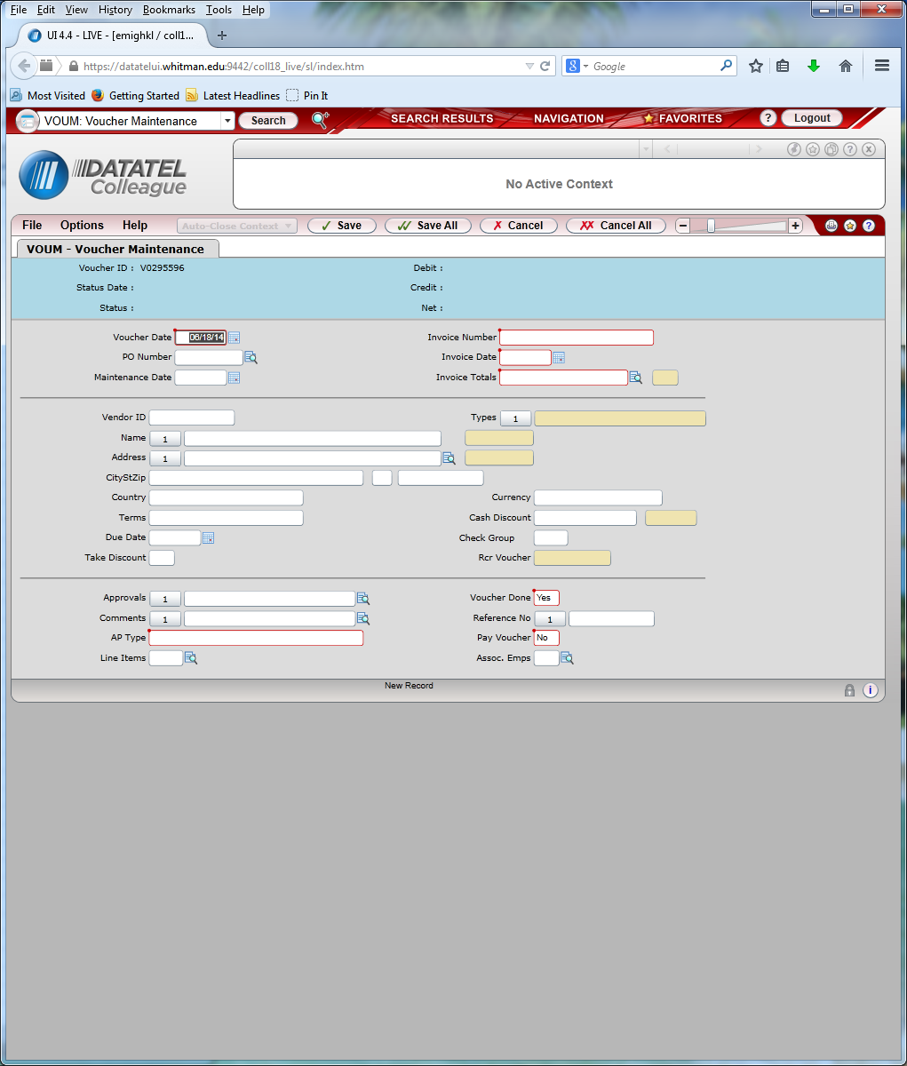
Paying Invoices (Voucher entry)

Slide 12
INVOICE DATE
Enter the invoice date as the date the goods and services were provided. This is especially important after June 30th.
The invoice date is used to search for goods and services that were received in the prior fiscal year but paid for after the end of the year (unrecorded liabilities).
Beginning now, please list the date received on invoices for supplies. You can also include packing slips with the invoices. Again, please note on the packing slip the actual date of receipt.

Slide 13
Service Department Charges
All interdepartmental charges for the current fiscal year (through June 30th) need to be submitted to payables@whitman.edu no later than the 10th of July.
If you can’t meet this deadline, contact us.

Slide 14
Petty Cash
All remaining petty cash funds (object code 6299) need to be submitted to the Student Accounts Business Office (Memorial Room 233).
A journal entry recording the receipts with the credit to object code 6299 must be submitted through the standard journal entry process.
A vendor payment for petty cash for the next fiscal year needs to be completed in July.

Slide 15
Personal Reimbursements
For current year expenses prior to June 30th, cash requests can be taken to the Student Accounts Business Office (Olin Room 342) for cash.
After June 30th, submit these requests to Accounts Payable for a check.
PLEASE try to have all personal reimbursements entered prior to July 15th.

Slide 16
Travel Advances
All outstanding travel advances given for travel in the current fiscal year (ending June 30th, 2015) need to be reconciled and submitted to Abby Biddiscombe no later than July 15th, 2015
If a travel advance is needed for travel occurring after June 30th, contact us for the correct General Ledger account number to use (If needed prior to July 1st)

Slide 17
The End!
Communication is the most important element to ensure year-end reporting is correct. Please ask questions if you are not sure.
All feedback and suggestions are welcome – we need your input to continue to improve this process.

