Slide 1
Fiscal Year-End Procedures
FYE June 30, 2014

Slide 2
Paying Invoices (Voucher entry)
Dates are important in two places for fiscal year end closing:
Voucher Date
Invoice Date
Do not automatically use current date as VOUCHER DATE when entering vouchers in VOUM
Invoice dates are VERY important when entering vouchers after June 30

Slide 3
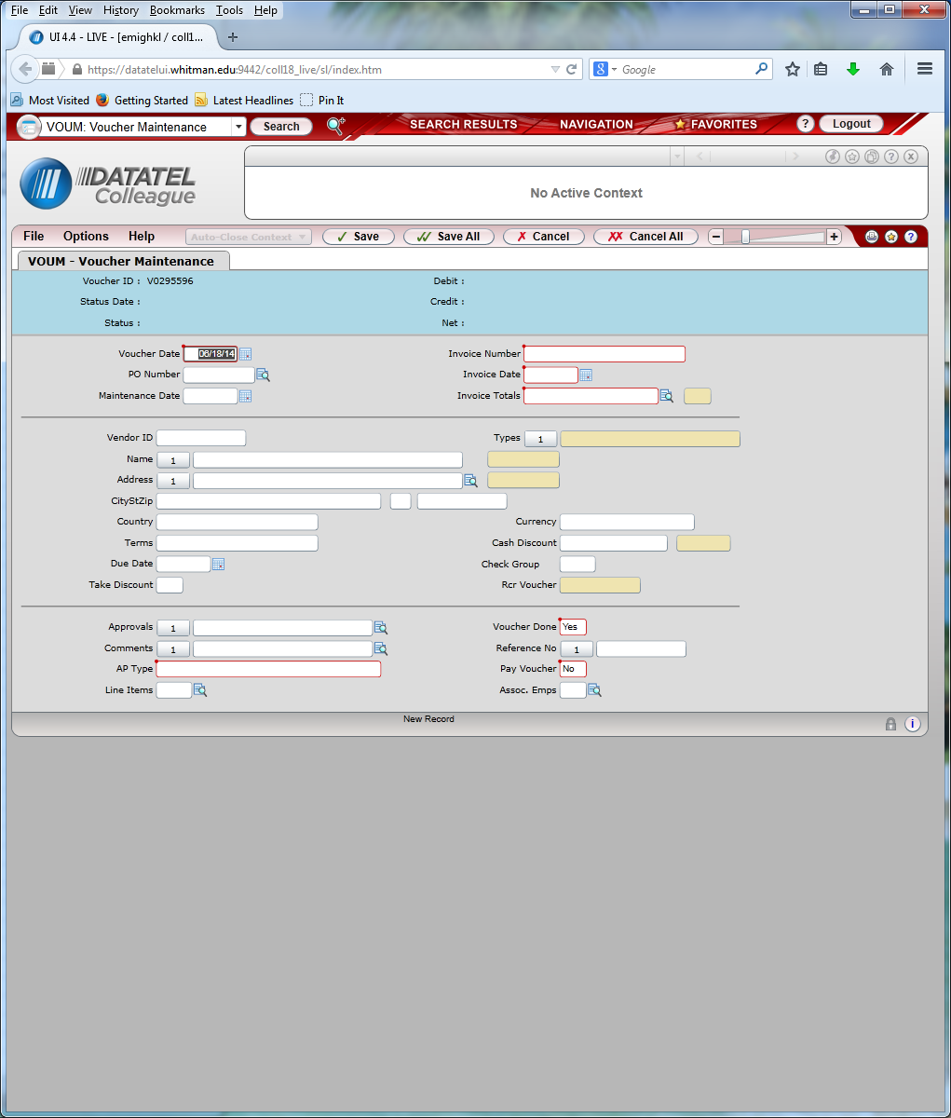
Paying Invoices (Voucher entry)

Slide 4
VOUCHER DATE
For vouchers entered prior to July 1st - Use current date when paying for goods and services already received.
For vouchers entered July 1st through July 15th, use June 30th for VOUCHER DATE for goods and services received in June BUT use the current date for goods and services received in July.
For vouchers entered after July 15th, use the current date. If you receive an invoice after July 15th that is for the prior year (prior to July 1st), please flag that invoice or vendor payment with a post-it note or flag. These invoices will be charged to the year they are entered unless you contact us.

Slide 5
INVOICE DATE
Enter the invoice date as the date the goods and services were provided. This is especially important after June 30th.
The invoice date is used to search for goods and services that were received in the prior fiscal year but paid for after the end of the year (unrecorded liabilities).
Beginning now, please list the date received on invoices for supplies. You can also include packing slips with the invoices. Again, please note on the packing slip the actual date of receipt.

Slide 6
JpMorgan credit card transactions
Credit card transactions will post this way:
Charges included on June 20th statement will post to current fiscal year (ending June 30, 2014)
Charges included on July 20th statement will post to next fiscal year (ending June 30, 2015)
Recommendation was to make charges prior to June 15th to ensure they would post in the current fiscal year.
If you have charges that posted between June 20th and June 30th that you want included in the current fiscal year, contact us and WE CAN MAKE THAT HAPPEN!!!

Slide 7
Service Department Charges
All interdepartmental charges for the current fiscal year (through June 30th) need to be submitted to Kathy Yeager no later than the 10th of July.
If you can’t meet this deadline, contact us.

Slide 8
Petty Cash
All petty cash funds (object code 6299) need to be credited back into the 6299 account no later than the last working day in June by closing out expenses.
Petty cash for the next fiscal year needs to be taken out in July.

Slide 9
Personal Reimbursements
For current year expenses prior to June 30th, cash requests can be taken to the Student Accounts Business Office (Olin Room 342) for cash.
After June 30th, submit these requests to Accounts Payable for a check.
PLEASE try to have all personal reimbursements for cell phones entered prior to July 15th.

Slide 10
Travel Advances
All outstanding travel advances given for travel in the current fiscal year (ending June 30th, 2014) need to be reconciled and submitted to Abby LaLonde no later than July 15th, 2014
If a travel advance is needed for travel occurring after June 30th, contact us for the correct General Ledger account number to use (If needed prior to July 1st)

Slide 11
Payroll
Hourly Staff: Project hours for each employee for June 21-June 30.
Student Employees: Project hours for each student for June 9-June 30.
Use the Excel sheets sent to you with the Year-End memo, as they self total.
If overtime hours are expected, please note the number of hours in the overtime section of the form.
Do not forget to put the GL account at the top of the form.
Forms are due to Kellie Emigh by July 15th.

