Slide 1
Administrative Support
Workshop
January 16, 2014

Slide 2
WELCOME
Introduction
Accounts Payable
Payroll
General Ledger

Slide 3
Accounts Payable
Cindy Dickson

Slide 4
Payments

Slide 5
Frequent Questions about Payments
Why is my payment delayed?
How can I get my payment processed faster?
Which form do I use?
Should I, and can I enter Invoices, VP & TME’s?

Slide 6
Reasons for Delayed Payments
Missing information; paperwork
  Receipts
  Support documentation
Incorrect information; paperwork
  Wrong or missing voucher #
  Incorrect form
  W9 information doesn’t match Payee
  Incorrect General Ledger Information

Slide 7
Reasons for Delayed Payments
Missing Approvals
Batching and holding invoices instead of sending them daily.

Slide 8
Prevent Delayed Payments
The Business Office website has the most current forms for your use.
  TME
  VP
  W9
Reminders and Pop-ups in each field to help complete the forms accurately

Slide 9
Prevent Delayed Payments
Enter the Invoice, VP or TME into Colleague and include the voucher number on each payment request.
  Ensures accurate General Ledger input
  Allows a true verification of information

Slide 10
Invoices

Slide 11
Invoices
Definition:
  An invoice is a document issued by a vendor listing the price and product or services received.
This does not include statements, estimates, quotes, order acknowledgments, etc

Slide 12
Invoices
Use a stamp to code for payment if possible
Be sure to include:
Department Name
G/L account number
Department Authorization/Signature
Budget Officer Signature if over $5,000
Business Purpose if not clearly listed
Sales tax detail listed

Slide 13
Invoices
Discounts
Make sure you take advantage of any discounts the vendor is offering if possible.
Note the amount paying on the invoice.

Slide 14
Invoices
Do not write or stamp on the remittance portion of any invoice
Registration fees and Subscription renewals- the invoice usually is the renewal document, so make a copy and do all the coding and signing on the copy.
No need to make copies unless you need it to be sent with the check.

Slide 15
Vendor Payment form

Slide 16
Vendor Payment Form
The vendor payment form is to be used when no invoice is provided
Examples:
Receipt reimbursement
Email for a refund

Slide 17
Vendor Payment Form
The vendor payment form is also used when paying:
Honorariums
Services with a Personal Service Contract (PSC) or Performance Contract (PC)

Slide 18
Vendor Payment Form
Include your Dept. name & initials
Include a VP #
Business Purpose in Description
Correct Vendor/WID #
Payment Delivery Instructions
Correct Voucher #
Department signature
Budget Officer signature, if over $5,000
Include PSC or PC & W9*, if required
Include page 2 of PSC to report hours, if required.
*Vendor payment (name) must match W9 information

Slide 19
TME form
Travel, Meals & Entertainment

Slide 20
TME
The TME form is to be used for payment and reimbursement of all travel, meals and entertainment expenses.

Slide 21
TME
Include your Dept. name & initials
Business Purpose in Description
  Reason for expense (detailed)
  Location
  Dates
Correct Vendor/WID #
Payment Delivery Instructions
Correct Voucher #
Department signature
Budget Officer signature

Slide 22
Voucher Entry
The following steps help speed up the vendor payment process for all TME, Vendor Payment forms and invoice payments

Slide 23
Voucher Entry
Changes
Red fields are required fields
Default Pay Voucher “N”

Slide 24
Voucher Entry- Invoice # field
Invoices & TME (paid directly to Vendor)
Include the invoice number as listed on the invoice with spaces, dashes, and letters as they are shown
VP and TME’s (paid to individuals)
Begin field with VP or TME
The combination of the invoice number and the vendor number is what gives Colleague the correct information to show you the duplicate payment error.

Slide 25
Voucher Entry-Date Field
Invoices & TME (paid directly to Vendor)
The invoice date should be the date listed on the invoice, not the date the voucher is entered into the system or the order date
VP and TME’s (paid to individuals)
The invoice date should be the date listed on the payment form, not the date voucher is entered into the system.

Slide 26
Voucher Entry
Select the correct remittance address. If the correct remittance address is not available e-mail payables@whitman.edu and ask for it to be added/corrected.
Do not type address corrections in the voucher screen. It will not be saved.

Slide 27
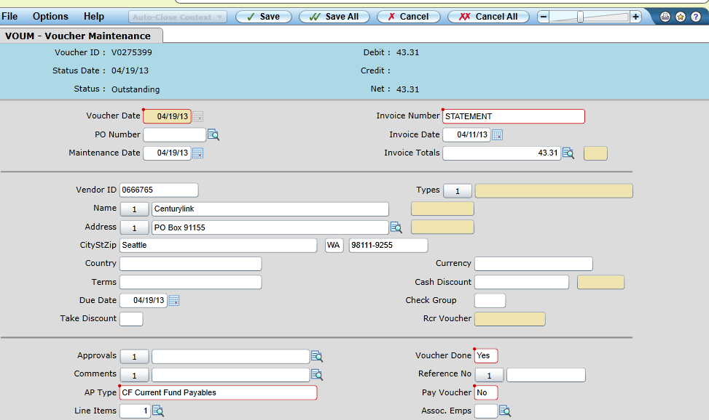
Voucher Entry (address look-up)

Slide 28
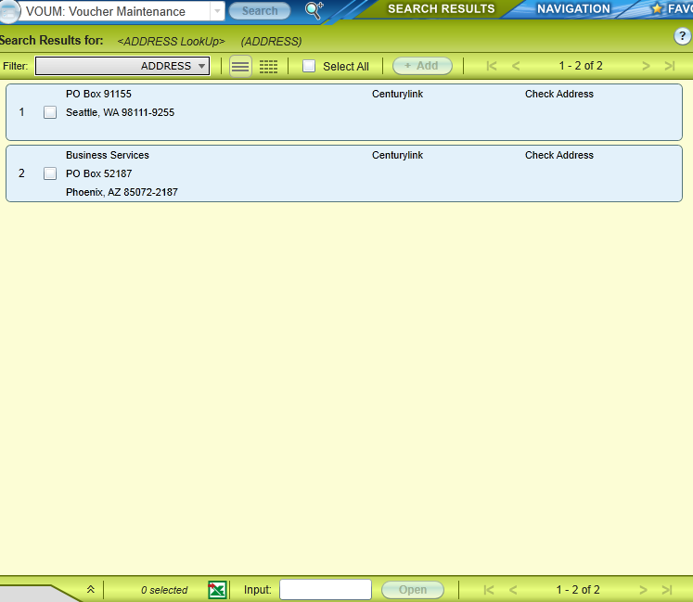
Voucher Entry (address look-up)

Slide 29
Voucher Entry
Third Screen for Direct Vendor Payment
(Invoices & some TME’s)
In description field, include the account number or customer number as listed on the invoice
If no account number is shown, use whatever makes that order unique; order #, po #, item description, folio #

Slide 30
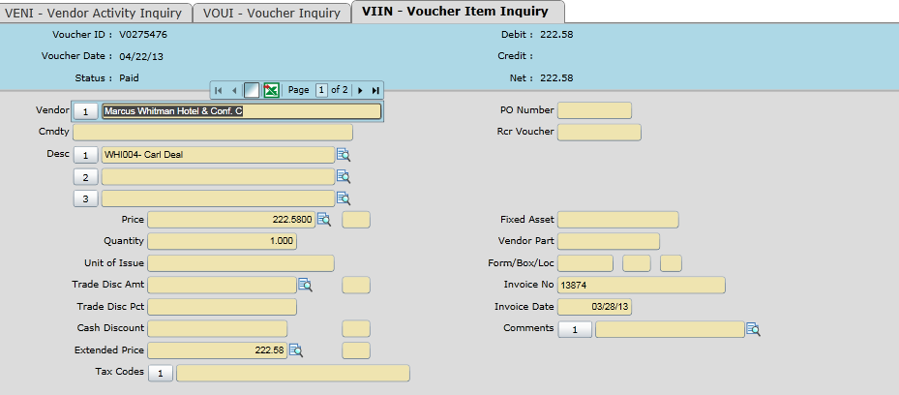
Voucher Entry-Invoices

Slide 31
Voucher Entry
Third Screen for Vendor Payment Form
In description field*, use identifying information so recipient knows what the payment is for.
Examples:
  RMB- books, supplies
  Honorarium, 4-18-13
  Performance fee, 4-18-13
  *We use this field to sort for reporting purposes as well as for tax reporting.

Slide 32
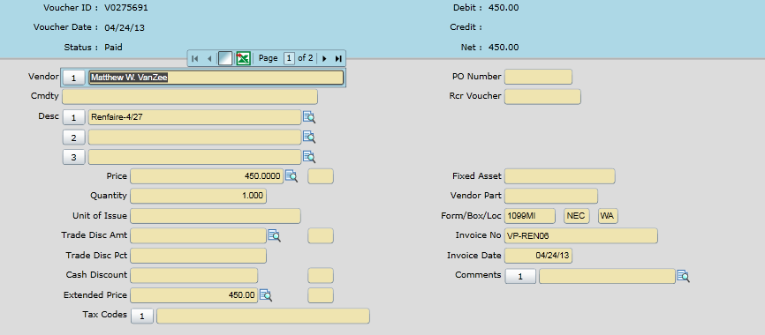
Voucher Entry- Vendor Payment

Slide 33
Voucher Entry
Third Screen for TME Form(individuals)
In description field*, include the location and date of the expense
Examples:
  Rmb- Japan- 4/5 – 5/5
  Rmb- airfare- SEA 4/15 – 4/30
  Rmb- trvl- CA- 5/2 – 5/22
*We use this information for IRS reporting requirements.

Slide 34
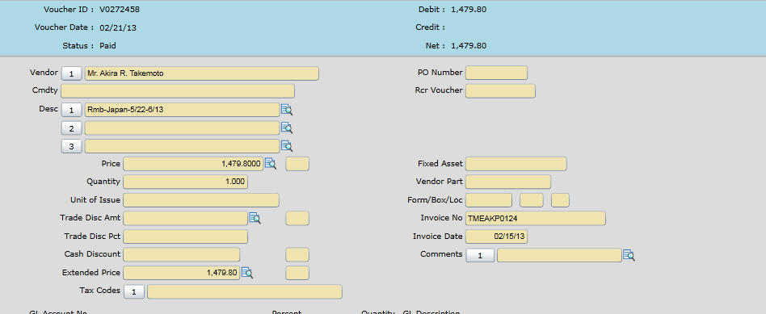
Voucher Entry- TME (individuals)

Slide 35
Voucher Entry- Use tax
Check for sales tax.
Enter ‘UT’ in the tax code field if it was not added to invoice or paid when the expense was incurred.
Use tax will be added to the amount in the price field of the VOUD screen.
You can use two VOUD screens if only a portion of the amount needs use tax added

Slide 36
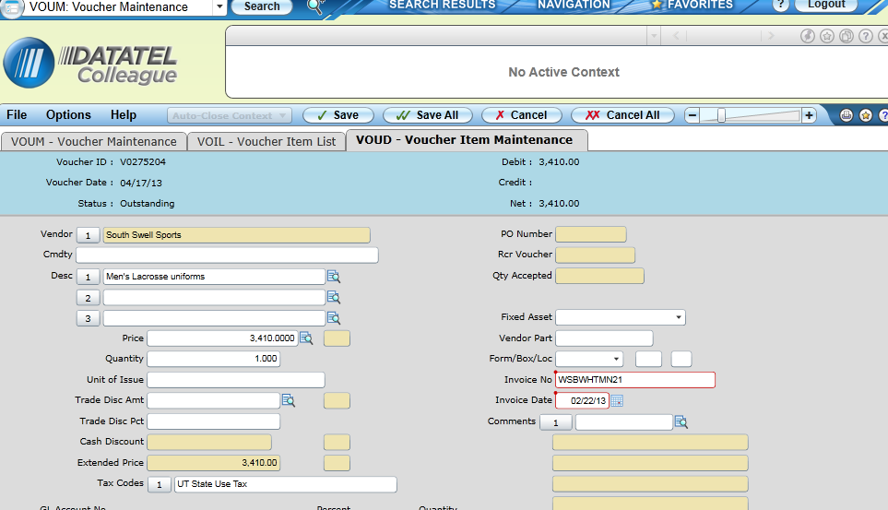
Voucher Entry

Slide 37
Voucher Entry
Multiple G/L account numbers
Enter first G/L account in field
Enter the amount to be charged in the amount field
‘Enter’ or ‘Tab’ to advance to a blank G/L account number field
Repeat until total amount has been distributed

Slide 38
Voucher Entry
Make sure to save your screens before ‘canceling’ out of them
Use VOIL screen to verify that your voucher is in balance
Make sure to note the voucher number on the invoice, VP or TME
Make sure ‘Invoice done” field is ‘Yes”
Make sure “Pay Voucher’ field is ‘No’
SAVE

Slide 39
Questions?

Slide 40
Payroll
Kellie Emigh

Slide 46
General Ledger
Kathy Yeager

Slide 53
Associate Controller
Susan Brown

