Slide 1
Administrative Support Workshop
Updates & Upcoming Changes
December 2013

Slide 2
WELCOME!
Introductions
Updates and Upcoming Changes
Got Questions – Ask Away!!

Slide 3
Payroll
Kellie Emigh

Slide 4
Upcoming Changes (Currently in Transition)
Payroll
Human Resources
W-2’s
All Timesheets
All Payroll Processing
W-4 Changes
Direct Deposit
All hiring (students included)
Benefits
Pay rate changes

Slide 5
We Need Your Input!!
These are changes we are considering:
For student timesheets - Thoughts on changing the approval deadline to the 10th?
Thoughts on setting both student and supervisor deadline to the same date and time?
This is why: …..

Slide 6
Accounts Payable
Cindy Dickson

Slide 7
Master Vendor File
New Vendors
Address Updates
Email for each vendor; containing the vendor’s name and address in the body of the email
W9 for all new vendors
Email with the vendor’s WID #
Note in email if it is a new address or additional address

Slide 8
Upcoming Colleague Screen Improvements
VOUM Screen
Default Pay Voucher to ‘N’
Red fields; required fields

Slide 9
Upcoming Colleague Screen improvements
VEND Screen
Vendor look-up access
W9 info noted in the comments field

Slide 10
Upcoming New Disbursement Option
Test group
Web Advisor input
Reimbursements for faculty, staff and students
E-checks

Slide 11
JPMorgan SmartData Conversion
Kathy Yeager

Slide 12
New Reconciliation Software
Smart Data is our new reconciliation software replacing PaymentNet.

Slide 13
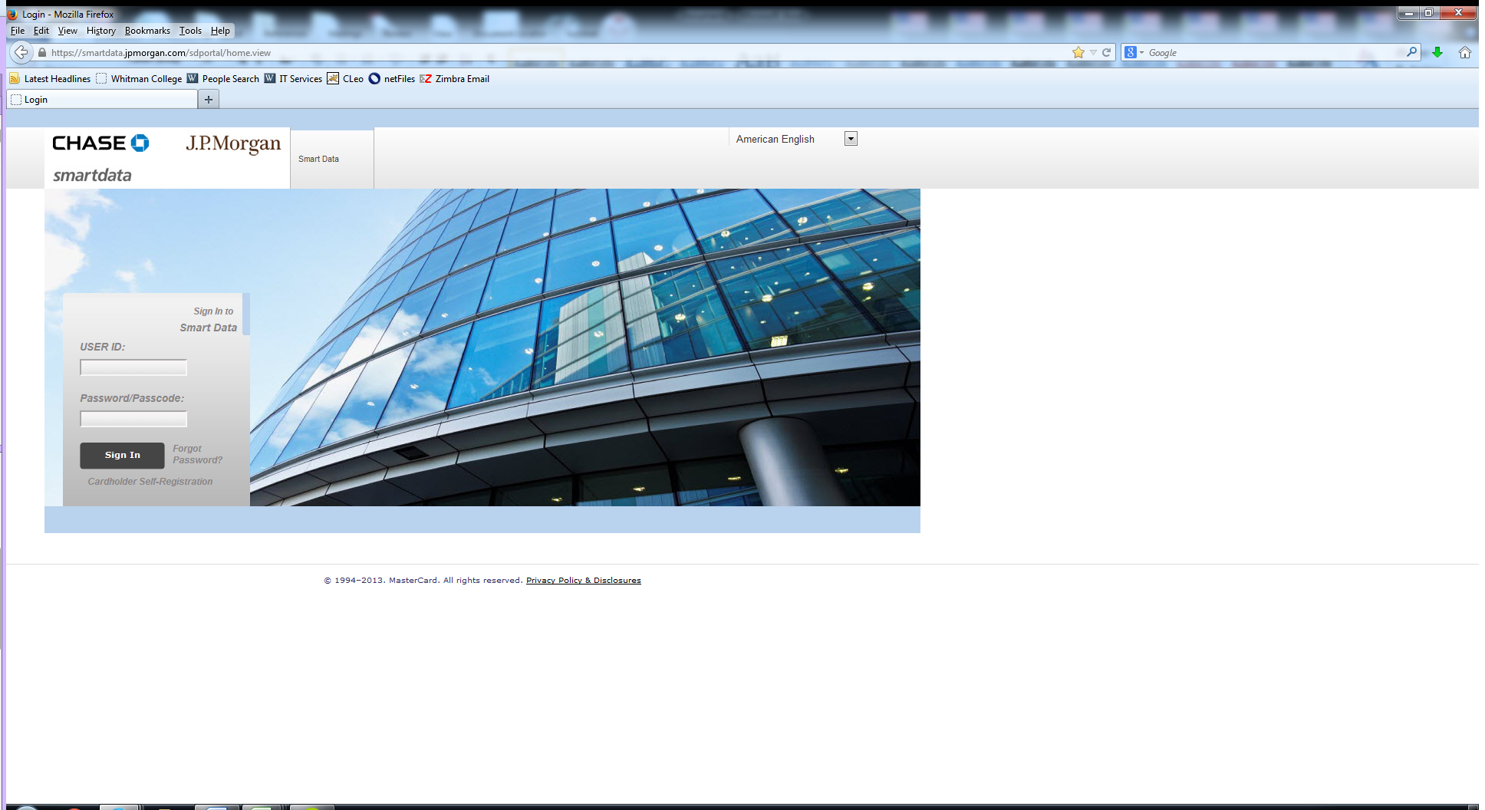
Sign in screen

Slide 14
Home Page

Slide 15
Associate Controller
Susan Brown

Slide 16
RESULTS OF….
Annual Financial Statement Audit
Business Office External Review

Slide 17
More Input Needed From You!
Next Workshop in January
Date???
Topics???

