Slide 1
Payments to Vendors
Workshop

Slide 2
Master Vendor File
How to request a New Vendor

Slide 3
New Vendor Requests
Email Cindy Dickson payables@whitman.edu
  Subject line: New vendor
  Body of email: Include the vendor’s name and address
  Attach a completed W9.

Slide 4
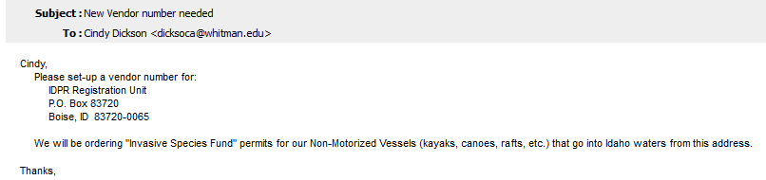
Email

Slide 5
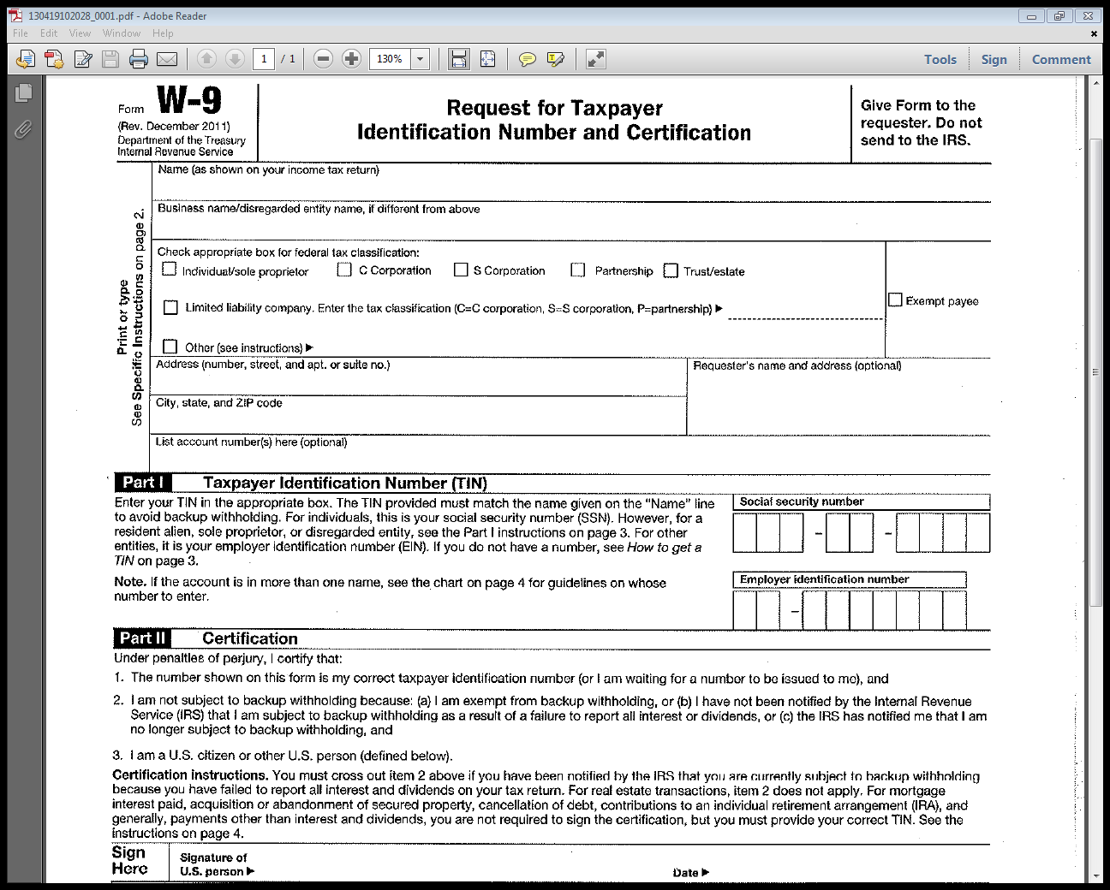
W-9

Slide 6
New Vendor Documentation
Why do we require written requests (email) for new vendors?
  An Internal Control to ensure only legitimate vendors are being set up
  Documentation for Audit purposes
Why do we require a W9 for all New Vendors?
  To ensure proper vendor set-up
  IRS reporting purposes

Slide 7
Payments

Slide 8
Payments
Why are payments delayed?
How can I get my payment processed faster?
Which form do I use?
Should I and can I enter Invoices, VP & TME’s?

Slide 9
Reasons for delayed payments
Missing information; paperwork
  Receipts
  Support documentation
Incorrect information; paperwork
  Wrong or missing voucher #
  Incorrect form
  W9 information doesn’t match Payee
  Incorrect General Ledger Information

Slide 10
Reasons for delayed payments
Missing Approvals
Batching and holding invoices instead of sending them daily.

Slide 11
Prevent Delayed Payments
The Business Office website has the most current forms for your use.
http://www.whitman.edu/content/business_
office/businessofficeforms
Reminders and Pop-up in each field to help complete the forms accurately

Slide 12
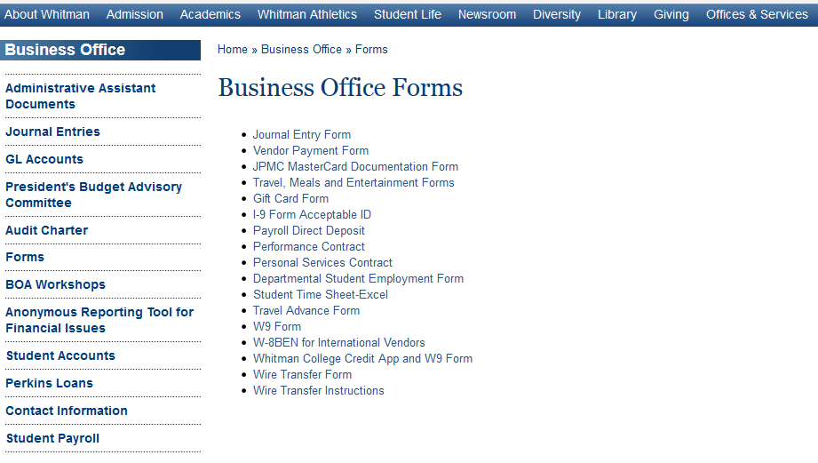
Forms Location on Website

Slide 13
Prevent Delayed Payments
Enter the Invoice, VP or TME into Colleague and include the voucher number on each payment request.
  Ensures accurate General Ledger input
  Allows a true verification of information

Slide 14
invoices

Slide 15
Invoices
Definition:
An invoice is a document issued by a vendor listing the price and product or services received.
This does not include statements, estimates, quotes, order acknowledgments, etc.

Slide 16
Invoices
Use a stamp to code for payment if possible
Be sure to include:
Department Name
G/L account number
Department Authorization/Signature
Budget Officer Signature if over $5,000
Business Purpose if not clearly listed
Sales tax detail listed

Slide 17
Invoices
Discounts
Make sure you take advantage of any discounts the vendor is offering if possible.
Note the amount paying on the invoice.

Slide 18
Invoices
Do not write or stamp on the remittance portion of any invoice
Registration fees and Subscription renewals- the invoice usually is the renewal document, so make a copy and do all the coding and signing on the copy.
No need to make copies unless you need it to be sent with the check.

Slide 19
Vendor payment form

Slide 20
Vendor Payment Form
The vendor payment form is to be used when no invoice is provided
Examples:
Receipt reimbursement
Email for a refund

Slide 21
Vendor Payment Form
The vendor payment form is also used when paying:
Honorariums
Services with a Personal Service Contract (PSC) or Performance Contract (PC)

Slide 22
Vendor Payment Form
Include your Dept. name & initials
Business Purpose in Description
Correct Vendor/WID #
Payment Delivery Instructions
Correct Voucher #
Department signature
Budget Officer signature, if over $5,000
Include PSC or PC & W9*, if required
Include page 2 of PSC to report hours, if required.
*Vendor payment (name) must match W9 information

Slide 23
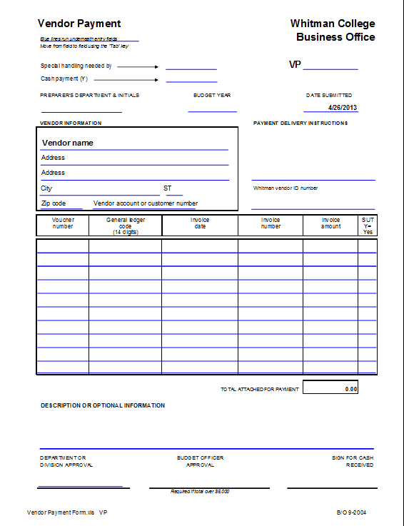

Slide 24
Voucher Entry
The following steps help speed up the vendor payment process for all TME, Vendor Payment forms and invoice payments

Slide 25
Voucher Entry- Invoice # field
Invoices & TME (paid directly to Vendor)
Include the invoice number as listed on the invoice with spaces, dashes, and letters as they are shown
VP and TME’s (paid to individuals)
Begin field with VP or TME
The combination of the invoice number and the vendor number is what gives Colleague the correct information to show you the duplicate payment error.

Slide 26
Voucher Entry-Date Field
Invoices & TME (paid directly to Vendor)
The invoice date should be the date listed on the invoice, not the date the voucher is entered into the system or the order date
VP and TME’s (paid to individuals)
The invoice date should be the date listed on the payment form, not the date voucher is entered into the system.

Slide 27
Voucher Entry
Select the correct remittance address. If the correct remittance address is not available e-mail payables@whitman.edu and ask for it to be added/corrected.
Do not type address corrections in the voucher screen. It will not be saved.

Slide 28
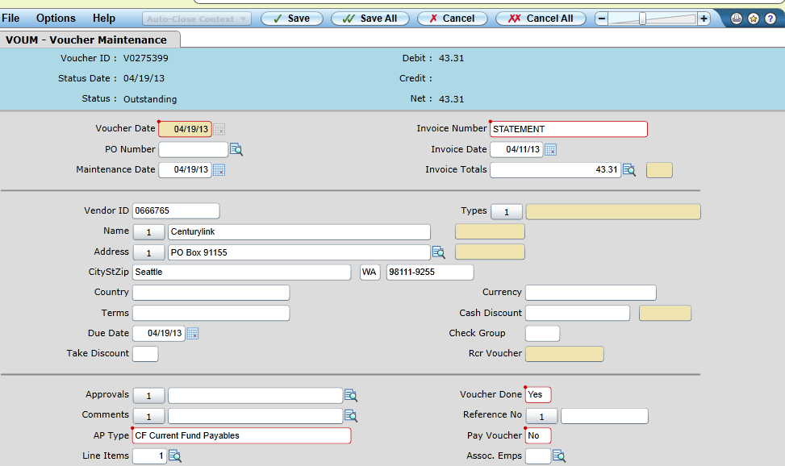
Voucher Entry (address look-up)

Slide 29
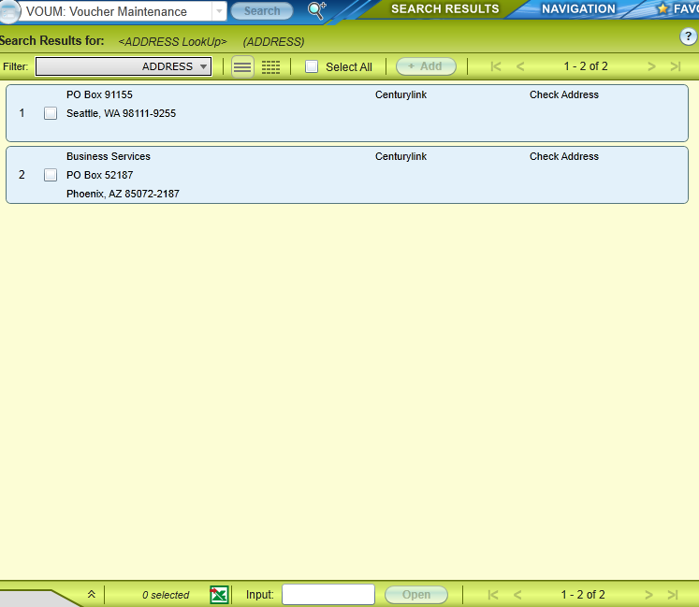
Voucher Entry (address look-up)

Slide 30
Voucher Entry
Remember to change the “pay voucher” field from “Y” to “N” (no)! and note the voucher number on the front of the paperwork

Slide 31
Voucher Entry
Direct Vendor Payment, third screen
(Invoices & some TME’s)
In description field, include the account number or customer number as listed on the invoice
If no account number is shown use whatever makes that order unique; order #, po #, item description, folio #

Slide 32
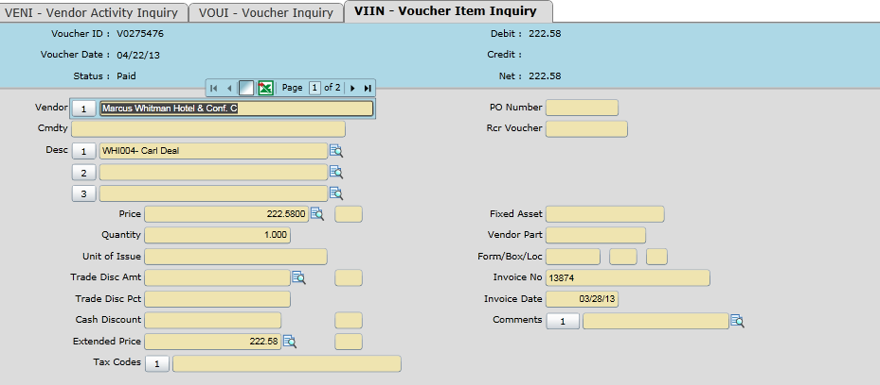
Voucher Entry-Invoices

Slide 33
Voucher Entry
Vendor Payment Form, third screen
In description field*, use identifying information so recipient knows what the payment is for.
Examples:
  RMB- books, supplies
  Honorarium, 4-18-13
  Performance fee, 4-18-13
  *We use this field to sort for reporting purposes as well as for tax reporting.

Slide 34
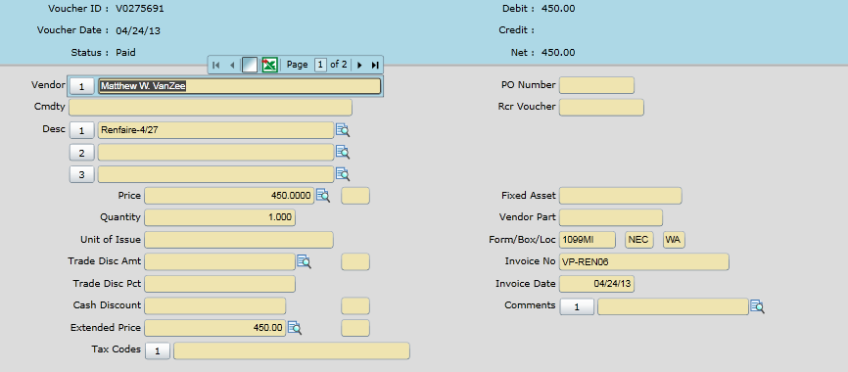
Voucher Entry- Vendor Payment

Slide 35
Voucher Entry
TME Form(individuals), third screen
In description field*, include the location and date of the expense
Examples:
  Rmb- Japan- 4/5 – 5/5
  Rmb- airfare- SEA 4/15 – 4/30
  Rmb- trvl- CA- 5/2 – 5/22
*We use this information for IRS reporting requirements.

Slide 36
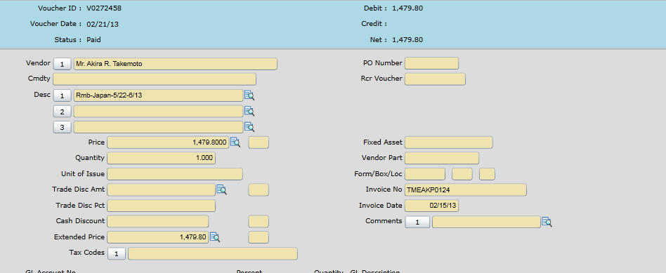
Voucher Entry- TME (individuals)

Slide 37
Voucher Entry- Use tax
Check for sales tax.
Enter ‘UT’ in the tax code field if it was not added to invoice or paid when the expense was incurred.

Slide 38
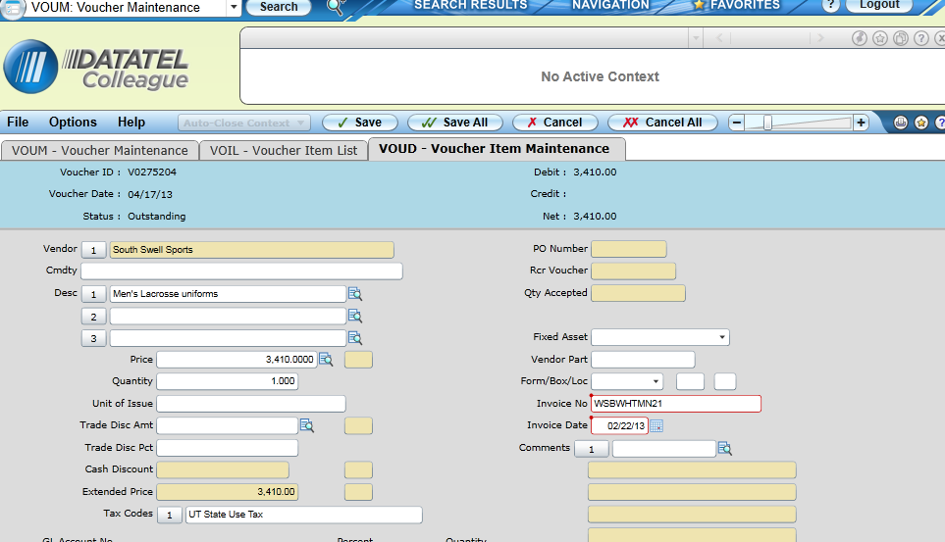
Voucher Entry

Slide 39
QUESTIONS?

