Slide 1
Direct Loan Exit Counseling

Slide 2
Our Agenda
Your packet
Loan types and interest rates
The grace period
Average loan debt for your class
Repayment plans and incentives
Avoiding delinquency and default

Slide 3
Key players…
Financial aid office
Federal government - studentloans.gov
Loan Servicer
FedLoan Servicing
Great Lakes
Navient/Sallie Mae
Nelnet

Slide 4
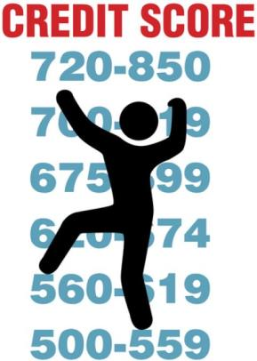
More key players…
Credit bureaus
Experian
Equifax
TransUnion
www.annualcreditreport.com
Ombudsman
1-877-557-2575
www.ombudsman.ed.gov
NSLDS
www.nslds.ed.gov

Slide 5
Direct Subsidized Loans (formerly known as Subsidized Stafford Loans)
Need-based
The federal government pays the interest
While in School
During 6 month Grace Period…but not for loans disbursed during the 2012-13 & 2013-14 school years.
Payment deferred (not required) while in school

Slide 6
Direct Unsubsidized Loans (formerly known as Unsubsidized Stafford Loans)
Not need-based
Interest begins accruing at disbursement
You are not required to make payments while in school, however it is an option
Interest capitalizes
Unpaid interest is added to the principal
Increases total debt and monthly payment

Slide 7
Direct Loan Interest Rates and Fees
 | Subsidized Rate | Unsubsidized Rate | Loan fee
2012-13 | 3.40% | 6.80% | 1%
2013-14 | 3.86% | 3.86% | 1.051% After 11/30/13: 1.072%
2014-15 | 4.66% | 4.66% | 1.072% After 9/30/14: 1.073%
2015-16 | 4.29% | 4.29% | 1.073% After 9/30/14: 1.068%
2016-17 | 3.76% | 3.76% | 1.068% After 10/01/2016 1.069%

Slide 8
Perkins Loans
Need-based
Grace period is 9 months
Interest rate is 5%
The federal government pays the interest
While in School
During Grace Period
Payment deferred (not required) while in school

Slide 9
Perkins Loans
Once you graduate…
Whitman is your lender; your servicer is University Accounting Service
https://uasecho.com
Your Whitman point-of-contact for Perkins Loans is the Student Accounts Office
(509) 527-5143
stuacct@whitman.edu
Memorial 233

Slide 10
The Grace Period
One-time grace period
Subsidized and Unsubsidized Loans – 6 months; Perkins Loans – 9 months
Begins after you graduate, leave school, or drop below 6 credits
Monthly payments begin when your grace period ends
You are responsible for the interest that accrues on
Direct Unsubsidized Loans
Direct Subsidized disbursed between 7/1/12 and 7/1/14

Slide 11
National Student Loan Data System
www.nslds.ed.gov
Central database for student aid records
Track federal loans from disbursement to payoff
Total student loan indebtedness
Loan status and interest rate
Find the servicer for your loans

Slide 12
2017 Whitman College Federal Student Loan Average
$19,605
(4-year private average: $29,214)
Estimated monthly payment: $197
Total Paid (Loan + Interest): $23,596*
*A Direct Subsidized Loan repaid at 3.8% interest, assuming the standard repayment plan of 10 years, or 120 payments

Slide 13
Repayment Plan Options
Standard
Graduated
Extended
Income-Based (IBR)
Income-Contingent (ICR)
Pay As You Earn (PAYE)
Consolidation

Slide 14
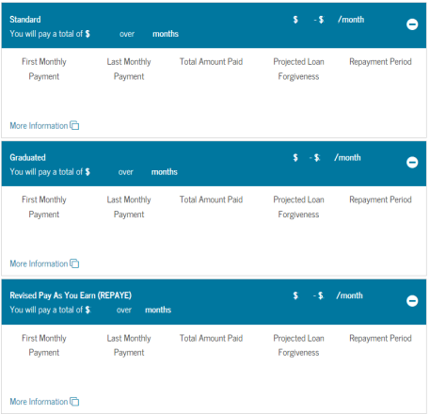
Repayment Calculator
https://studentloans.gov/myDirectLoan/repaymentEstimator.action
Log in with your FSA ID, and the estimator will show you what repayment options will look like based on your loan history.
Compares all repayment options

Slide 15
Money Saving Benefits
Interest rate reductions-
Consecutive, on-time, monthly payments
Sign up for automatic payments
Check with servicer for details
Tax credits and deductions-www.irs.gov

Slide 16
Your rights
Receive a copy of your signed MPN (master promissory note)
Receive a disclosure statement
Receive a six month grace period
Prepay all or part of your loan without penalty
Deferments and forbearance, if eligible
Written notice if your loan is sold
Proof of discharge after repaying loan in full

Slide 17
What are your responsibilities?
Repay your loan(s)
Make on-time, monthly payments
Read correspondence from servicer
Notify the servicer of changes within 10 days- School and enrollment status and name, address and phone number
Ask your servicer for help!

Slide 18
Avoid Delinquency and Default
Pay on time!
A payment received one day late is considered delinquent
Delinquent payments are reported to the credit bureau
Always call your servicer or school for help

Slide 19
Consequences of Default
Full amount of loan is due
Including collection costs
Subject to federal and state offsets
Wages and tax refund may be garnished
Credit will be tarnished
Loss of deferment and forbearance options
Loss of eligibility for future financial aid
May lose eligibility for certain federal or state jobs
May lose professional license

Slide 20
Deferment
Postponement of payments
Not automatic
You must apply and receive approval from your servicer
Most common reasons deferment is granted: you are in school, unemployed, have economic issues (hardship) or are in the military service.
When subsidized loans are deferred, the federal government pays the interest.

Slide 21
Forbearance
Temporary reduction or postponement of payments
This is also not automatic!
You must apply and receive approval from the lender/servicer.
Primary reasons
Poor health
Residency program
Financial hardship
Interest will continue to accrue, even on subsidized loans

Slide 22
Loan Forgiveness
Volunteer work
Military service
Teach or practice medicine in certain communities
Other loan forgiveness
www.studentaid.ed.gov
Americorps- www.americorps.gov
Peace Corps- www.peacecorps.gov

Slide 23
Public Service Loan Forgiveness
Encourages public service careers by forgiving the balance of borrowers’ loans after they make 120 qualifying payments
Only available for Direct Loan program (DL) loans
You must be employed full time in an eligible public service job
You must make 120 eligible monthly payments on or after October 1, 2007, while employed full time in an eligible job.
Forgiveness will only be granted while you are still employed full time in an eligible public service job.

Slide 24
Loan Cancellation
In extreme circumstances-
Total and permanent disability
Inability to complete course of study due to school closure
False certification by the school
Death

Slide 25
So, what are the keys to successful repayment?
Keep school and servicer informed about changes, especially if you move.
Keep copies of all documents in one place
Open all mail
The longer it takes to repay your loans, the more interest you will pay
Build good credit with timely payments
Always ask for help!

Slide 26
Questions?
Contact us!
Email:
finaid@whitman.edu
Call:
(509) 527-5178

